Slide 1
Distributed Development:
Lessons learned by Herschel
GRITS 2011, June 17
Colin Borys

Slide 2
Overview
Ground Segment Organizational chart
The Practical considerations
General Development Infrastructure
Inherent conflicts and how to cope
Summary of lessons learned

Slide 3
Organizational chart
Archive
System
Instrument Control Centers (ICCs)
Core
Each software area manages their own CCB (configuration control board), which prioritizes work.
Each also has their own manager and software QA.

Slide 4
Practical Considerations
The System Architect, QA Engineer, and top level managers define the entire development framework. Hire good ones!
With developers spread across ~15 timezones, interaction is a challenge:
With Europe, we generally have telecons at their end of day/our start of day. (6am)
NHSC also has a representative onsite at ESAC (Madrid) to represent us at other meetings. (David Ardilla)
The emergence of social networking, SKYPE, and now webex are also invaluable

Slide 5
Development Infrastructure
IDE: Eclipse. Common, powerful, and has the ability to import project-specific plug-ins to aid in development conformity
Code Repository: CVS. Old, but it works.
Ticketing System: JIRA. Very effective, very configurable.
Compilation: CIB (Continuous Integration Build) approach.
Testing: Test harnesses, nightly tester, once per release acceptance testing.

Slide 6
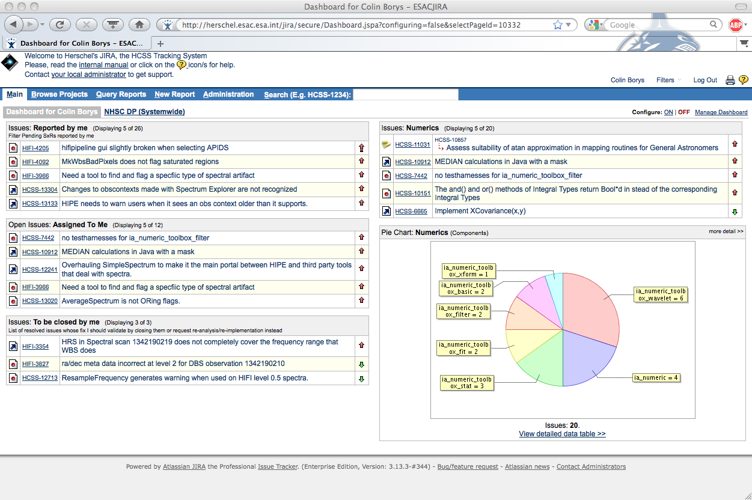
(some) Lessons Learned

Slide 7
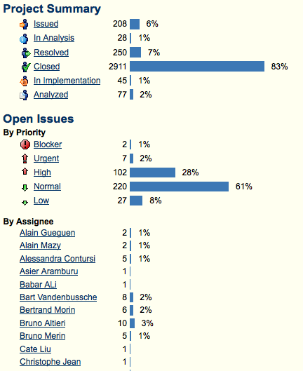
(some) Lessons Learned

Slide 8
JIRA workflow for a person who submits a ticket
User submits a ticket
Developer analyzes issue
Developer starts implementation
Developer fixes issue
User tests implementation
Ticket appears on users’ ‘submitted by me’ panel
Ticket appears on developer’s ‘assigned to me’ panel
Ticket status is ‘Assigned’
Ticket status is changed to ‘In Analysis’
Ticket status is changed to ‘In Implementation’
Ticket status is changed to ‘Resolved’
Ticket disappears from developer’s panel
Ticket appears on users’ ‘to be closed by me’ panel
If test passed, user sets the ticket to ‘Completed’ and the workflow is complete.
E-mail is sent to assignee, developer, and mentor at each step

Slide 9
Consequences of JIRA workflow policy
In our setup, the person who submits a bug report is also responsible for testing and closing the ticket once a developer fixes it.
We do not release software when a ticket assigned to that version is ‘resolved’ but not closed.
It is natural for a lot of development to happen near a code freeze, thus the testing duties for reporters get compressed.
Consequence is that people who report bugs are inherently punished and this provides some motivation to work ‘outside’ the system.

Slide 10
The HIPE ticketing interactions
Astronomers and User Groups
Workshops
JIRA
Helpdesk
HSC/ICC/NHSC
The user base cannot directly submit tickets, but overhead on developers is lower.
Increased need for calibration scientists to interact with community.
Developers

Slide 11
The Developer-Mentor policy
HIPE is made up of >100 component packages (i/o, numerical, etc.)
For each, there is a developer (or more) and mentor assigned.
The majority of the packages have a calibration scientist as a mentor, and it is their job to :
Advise developer on astronomer specific issues
Vet tickets that are incorrectly assigned to a package
Advise management on the priority of tickets in that package.
Aid in documentation that is directed towards users.
Good idea but can fail in practice (over tasked, lack of expertise for shared packages with a broad user base, ignored)

Slide 12
Continuous Integration Builds
HIPE takes a long time to compile, and it used to be possible for conflicts to occur on packages under heavy development.
Was particularly problematic around a code freeze.
With a CIB, a new minor version of the software is created every time new code in a component is checked in. Therefore changes in package Y are immune to changes in X if Y is checked in first.
Any code that does break the build becomes ‘quarantined’, and the owners of X and Y figure out why, and fix it.

Slide 13
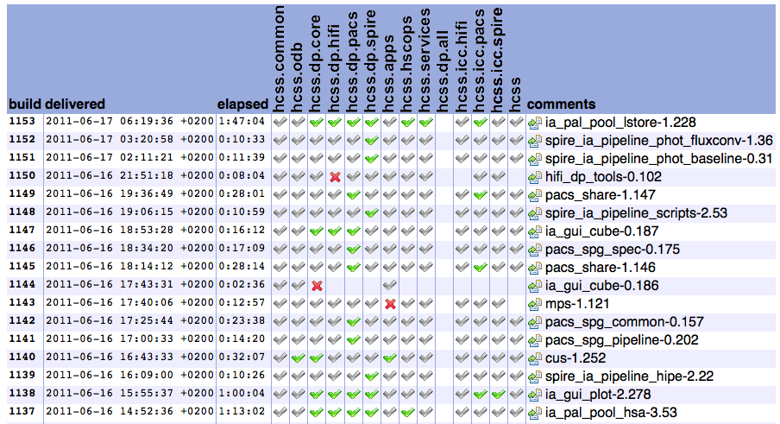

Slide 14
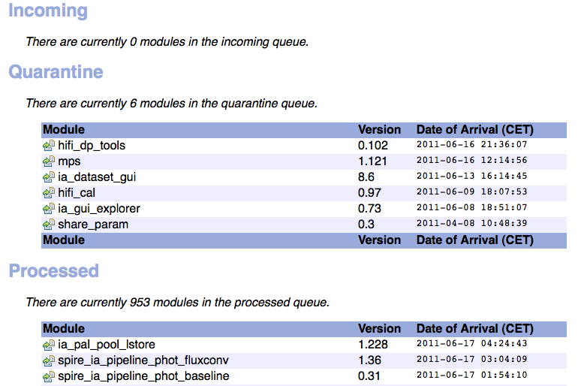

Slide 15
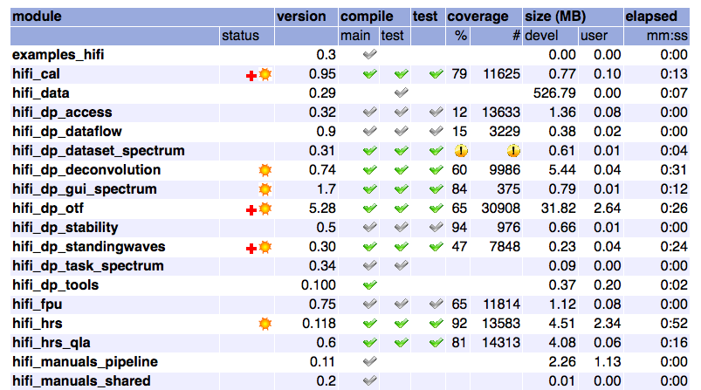

Slide 16
Software testing
Occurs at many levels, the first being the code test harnesses associated with each component. This is easily one of the most controversial areas we deal with.
Scripts designed to run the system in many different areas are automated once per night and the output compared to an expected value. This catches bugs that don’t break the build but do break the system. However does not test as much code as the test harnesses.
Finally, every major release goes through extensive acceptance testing.

Slide 17
Inherent conflicts
Developers and Astronomers often have a different view on how things should be implemented. Data access in HIPE for example is sophisticated and powerful, but until recently only expert Astronomers could actually read in data easily!
The US mandate is to support the US Astronomer. The European one also includes development of HIPE for future ESA missions. Code quality reviews places NHSC in a difficult position.

Slide 18
(some) Lessons learned
Know your colleagues, figure out who they work for, and what they are hired to do.
Don’t let developers write requirements, but don’t let astronomers limit developers.
Pair developers with calibration scientists
Hire good people at the top
Embrace new technologies/approaches (i.e. social media, CIB)
Purchase good development tools.
Monitor policy decisions…they often have unintended side-effects
Emphasize testing at every opportunity, but be flexible.
No amount of requirement or policy planning will prevent conflict.

