Slide 1
The Spitzer IRS Spectrophotometric Database
Patrick Ogle, Lee Armus, Bob Narron,
Carl Grillmair, Justin Howell, IRS IST

Slide 2
Integrating Spitzer IRS Archival data into IRSA and NED
Tap into the power of IPAC database search tools
Enable multi-wavelength science
IRSA: Original and enhanced multiwavelength data (e.g. IRAS, Spitzer, WISE, Planck, GALEX)
NED: Source ID’s, Bandmerging, Basic Data, Photometry/SEDs, all linked to published references.
Plan:
Deliver IRS Enhanced Spectra and Photometric DB to IRSA
Ingest Spitzer IRS Source catalog into NED; link to IRSA spectra

Slide 3
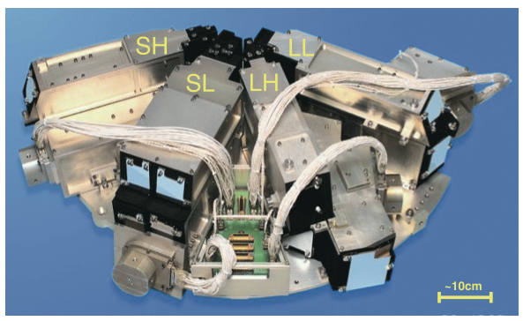
Spitzer IRS

Slide 4
Spitzer IRS (SINGS) Galaxy Targets

Slide 5
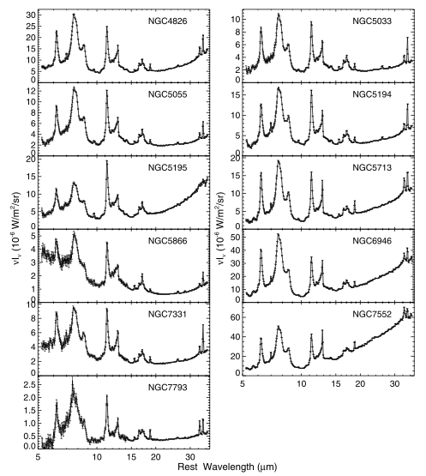
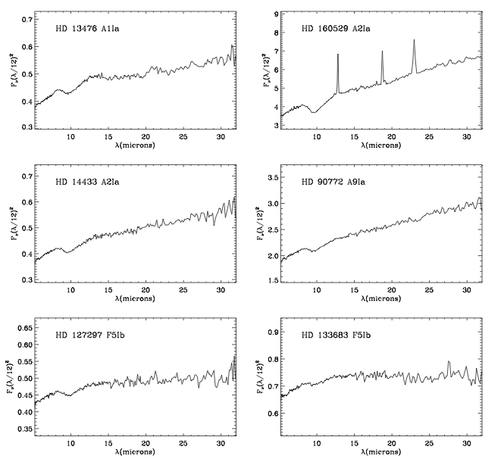
Spitzer IRS Spectra
Atlas of Stellar Spectra (Ardila 10)
SINGS Galaxies (Smith 07)

Slide 6
IRS Database Use Cases
Find spectra for all objects brighter than 1 Jy.
Search for red galaxies with MIPS24/IRAC8 >4.
Search for stars with 0.2<MIPS24/IRAC8<1 dust excess emission.
Cross-calibrate photometry
Spitzer instruments (IRAC,IRS,MIPS)
Other missions (IRAS, WISE).
Understand Spitzer and WISE source colors.

Slide 7
IRS Enhanced Spectra
17000 IRS observations
(low-resolution, staring mode)
Background-subtracted spectra
Nods averaged
Orders (SL1,2,LL1,2) trimmed and merged
Photometry in 6 (8) standard bands:
Spitzer IRAC8,PU16,22,MIPS24
IRAS 12,25
WISE bands 3 and 4 (12,22 micron)
Headers contain position, photometry,
and order matching info

Slide 8
Spitzer IRS Database Queries
ID, cross-ID (NED/Simbad), AORkey
Position—(RA,Dec) Requested and Extracted
Order matching (e.g. LL2/SL1 ratio)
Photometry—IRAC8, MIPS24, PU16,22, IRAS 12,25, [WISE12,22] and uncertainties
Colors—MIPS24/IRAC8, MIPS24/PU16, PU16/IRAC8, IRAS25/12, [WISE22/12]
[Cross-dispersion profile width]

Slide 9
IRSA/Gator Data Release
IRS Enhanced Spectra and Spectrophotometric Data to be released as “Spitzer Legacy” in 2011 Fall.
Flat-format ASCII table and searchable versions
Collection of merged spectra

Slide 10
SHA Interface (TBD)
SHA search on position, flux, color… (or any combination thereof)
Level 3 (IRS Enhanced) Products tab will give merged spectrum.
Spectrum, photometric data plotted in Details:Data tab

Slide 11
NED Interface

Slide 12
NED Search Results

Slide 13
Science Application I. Spitzer Cross-calibration

Slide 14
Science Application II. Star and Galaxy Colors

Slide 15
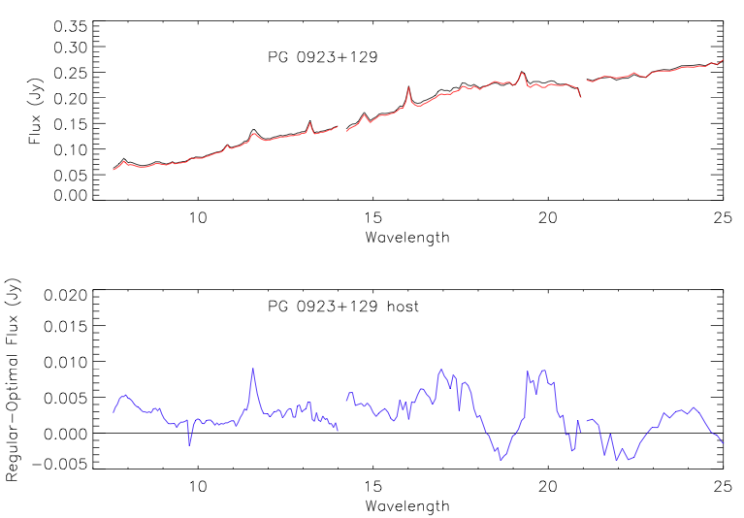
Science Application III. Quasar Host Galaxies
Difference between regular and optimal
extraction emphasizes extended host
galaxy emission (PAHs and continuum)
Extended quasar host emission revealed
by deficit between Spitzer IRS (enhanced)
and MIPS 24 photometry.

Slide 16
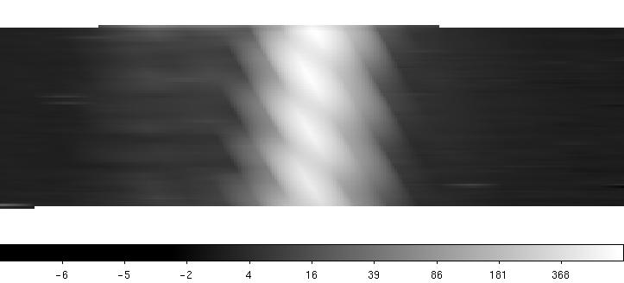
SPICE Optimal Extraction
Stellar PSF template
S/N-weighted spectral extraction, using SPICE GUI
Uses stellar (point-source) template for instrumental profile (PSF)

Slide 17
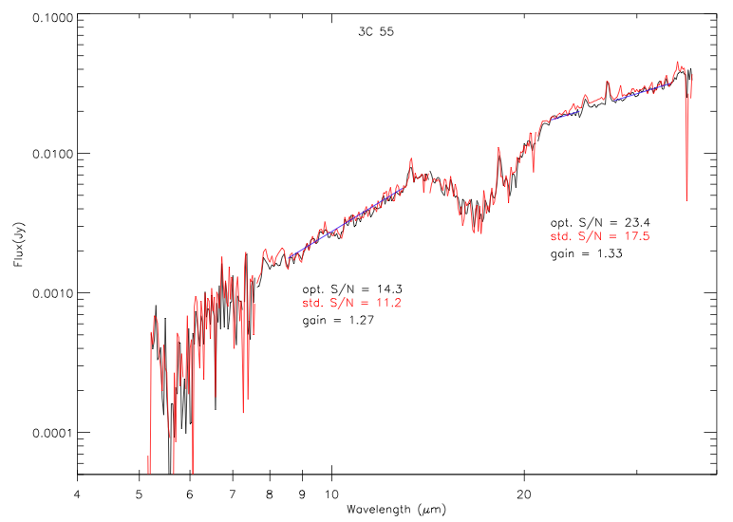
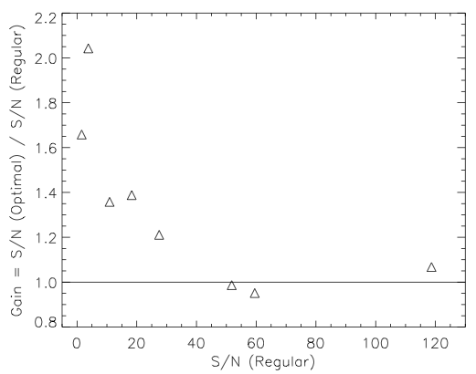
SPICE Optimal Performance
Faint radio galaxy 3C 55 regular vs. optimal
Signal-to-noise improvement of up to factor 2

Slide 18
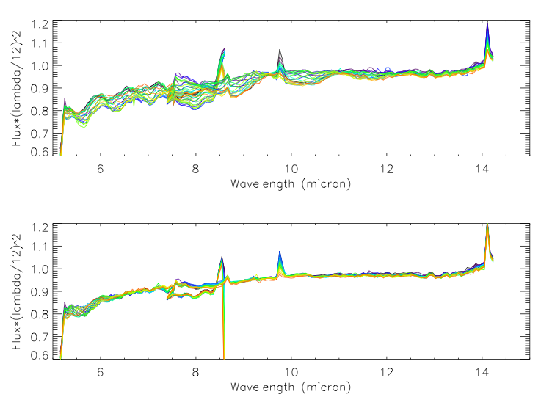
SPICE Optimal Extraction Upgrade
Before
After
Fix wiggles in SPICE optimal extraction
Finely sampled (0.1 pixel) spectral map of HR 7341 →better matched templates to science targets
Optimal extraction revised to pick closest stellar template (modulo 1 pixel)

