Slide 1
NASA/IPAC Teacher Archive Research Project (NITARP)
Luisa Rebull
NITARP Director
SSC
17 June 2011

Slide 2
NITARP in one slide
NITARP = NASA/IPAC Teacher Archive Research Program
NITARP is designed to give teachers an authentic research experience using real data and tools.
A group of teachers are paired with mentor astronomer, do research, write up results, take it to a professional meeting.
Three trips: (1) professional meeting to start, (2) visit Caltech/JPL for 3 days, (3) professional meeting to present results.
Aimed at high school teachers; middle school, community college, informal educators may also benefit.
(Originally funded out of Spitzer EPO; now funded out of Archival Research and EPO funds.)
Teacher application available Spring, due Fall; any US educator can apply.
Google NITARP to learn more! Or http://nitarp.ipac.caltech.edu

Slide 3
NITARP accomplishments (2004-date)
56 educators trained in real astronomy research.
53 science or education posters presented.
4 refereed articles published in major astronomical journals.
109 students (high school, middle school, college) visited IPAC and/or attended AAS meetings.
1200+ students used data through the program.
More than 100 students report that the program has influenced them to pursue careers in science or related fields.
Teachers and students have delivered ~200 presentations, reaching over 14,000 people.
At least 100 newspaper, radio, and tv reports (plus numerous internet articles) reported on various aspects of teacher and student involvement.
At least 43 high school students using their experiences in this program have received several regional and international science awards.
Notes:
Newest article came out in journal last week!

Slide 4
NITARP current events
Nearly 60 people affiliated with NITARP went to the American Astronomical Society meeting in January in Seattle, WA. (~2% of the meeting attendees!)
3 teams started up in Jan, wrote proposals in the Spring, and are coming to visit July-Aug!
At the AAS, 12 new educators in the start-up workshop, and ~50 people on the old teams presented 9 posters.
Sharing with you some of their experiences and reactions!

Slide 5
Most of the new teachers
At start-up workshop, Sunday, Jan 9

Slide 6
Most of the ~60

Slide 7
Demographics
Historically high school educators, nationwide.
Current class of educators: Largely high school; 2 informal educators (AZ NASA teacher resource center, amateur); FL, NH, VA, CT, PA, WI, MN, AZ, CA, OR, Kickapoo Nation (KS).
NB: 3 IPAC non-science staff continuing.
Last year’s educators: Largely high school; 1 8th grade; 2 non-traditional (Yerkes, …); 3 community college; PA, WI, IL, MN, CO, MT CA.
Students: Largely high school juniors and seniors, though some 8th graders through returning students in community college.
Note: 2 hearing impaired students and 1 visually impaired student from Wisconsin, plus teacher escorts.

Slide 8
Poster Presentations
Each team took one science and at least one outreach poster; up for one day each.
Total of NINE posters!!
I have a “team blog” posting up with words on each one (see http://www.spitzer.caltech.edu/ )
Examined AGN properties in IR (Spitzer) and UV (GALEX).
Found 19 entirely new young stars based on Spitzer data.
Found ring-like structures in a circumstellar disk (eps Aur).
Found stellar IR variables in exoplanet observations.
Each team had to stand by the poster, present results, answer questions.

Slide 9
Presenting their work

Slide 14
Groups get (re-)acquainted

Slide 15
Meeting “famous” people
Rob Gutermuth, who invented one of the techniques these folks used.

Slide 16
Meeting REALLY famous people
Tony Tyson (famous scientist) and Charles Simonyi (famous millionaire philanthropist), Tim Spuck (mentor teacher), Inga Saathoff (student)

Slide 17
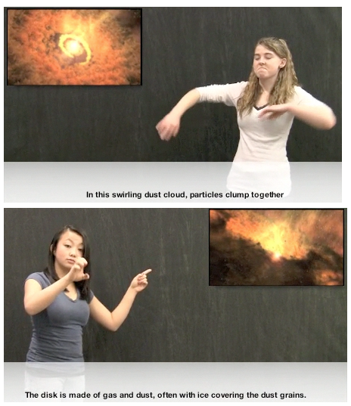
What’s the ASL for “accretion disk”??
This will hopefully be a Spitzer podcast!

Slide 18
Participant Reactions
Everyone: astronomers are normal, friendly people!
Teacher: “…never have I attended [a] convention where the overall collaborative nature of the attendees is so strong. Everyone that I came in contact with was approachable and eager to answer questions or contribute some knowledge.”
Student: “I found it comforting that most educators at that level seem to genuinely enjoy and love to talk about their area of interest.”
Student: “We had the great pleasure of talking to wonderful and brilliant people.”
Running with “the big kids”
“How cool for [our] kids [to] see a poster right next to theirs being presented by three university professors on one side and a graduate student on the other.”
“To think that I was able to make a new astronomical discovery for the first time in my life still inspires me to no end!”

Slide 19
Participant Reactions
Astronomy and Science in General
“I always thought just from programs on tv and in the classroom that astronomy was more or less completely figured out. Learning that it isn’t is pretty exciting.”
“My observation was that [our students'] ideas for their future expanded with the whole experience. That science became more than a class but an endeavor in which they could participate.”
“I have learned a lot over the past three years .. I actually understood much of what they were talking about!”
“Although I'm sure none of us understood every word of what these professionals said, the fact that we could wrap our minds around even parts of it proves that we've come a long way in our studies.”
“This was really exciting.”
Specific Astronomy Things
“My favorite lecture on Monday was on the topic of black holes and dark matter. This one really blew our minds; we learned that only 5% of the universe is made up of the atoms we all know and love!”
“It was neat that Kepler's first confirmed terrestrial planet was announced during the conference.”

Slide 20
Participant Reactions
Students: learning how to network. Making contacts at schools to which they have applied (or learning about new schools to which they should apply). Learning about summer opportunities.
Taking what they learned in their project and trying to go further:
“It was interesting to see that AGNs tend to exist in clusters, making me wonder how the AGNs we analyzed in our project were arranged.”
“X-Ray data could potentially be used to expand our project.”
“[I talked to xxx who] thought we might be able to get spectra for our YSO candidates from his …observatory colleagues and connections.”
“In my head I compared the rings of Saturn [Porco’s talk] to the disk structure around eps Aur [her project].”
Learning from each other (impaired kids were inspirational):
“Before this conference, I hardly thought about the different methods people with physical impairments would have to use to learn about [science]…science is for literally anyone who is curious and willing to learn, no matter what the current circumstances are.”

Slide 21
Ambassadors!
“…it invigorated me to become part of the greater message, which is the story of space and ground based observatories and the incredible infrastructure built by NASA and its commercial and institutional partners. Never in the history of this great science has so much data and use of incredible instruments been available to not just the scientific community but the general public as well. All one has to do is just ask!”
[One of the other teachers with whom I've been working now] sees herself as being able to teach science, [… and] wants to share this excitement and potential with others who are in deaf education who might never have thought that they could teach science. So many educators who work with students who have special needs […] specialize in supporting the needs of the students rather than the core STEM subjects[…] Becoming empowered in the language and the nature of inquiry and investigation was also life changing for our teacher participants.

Slide 22
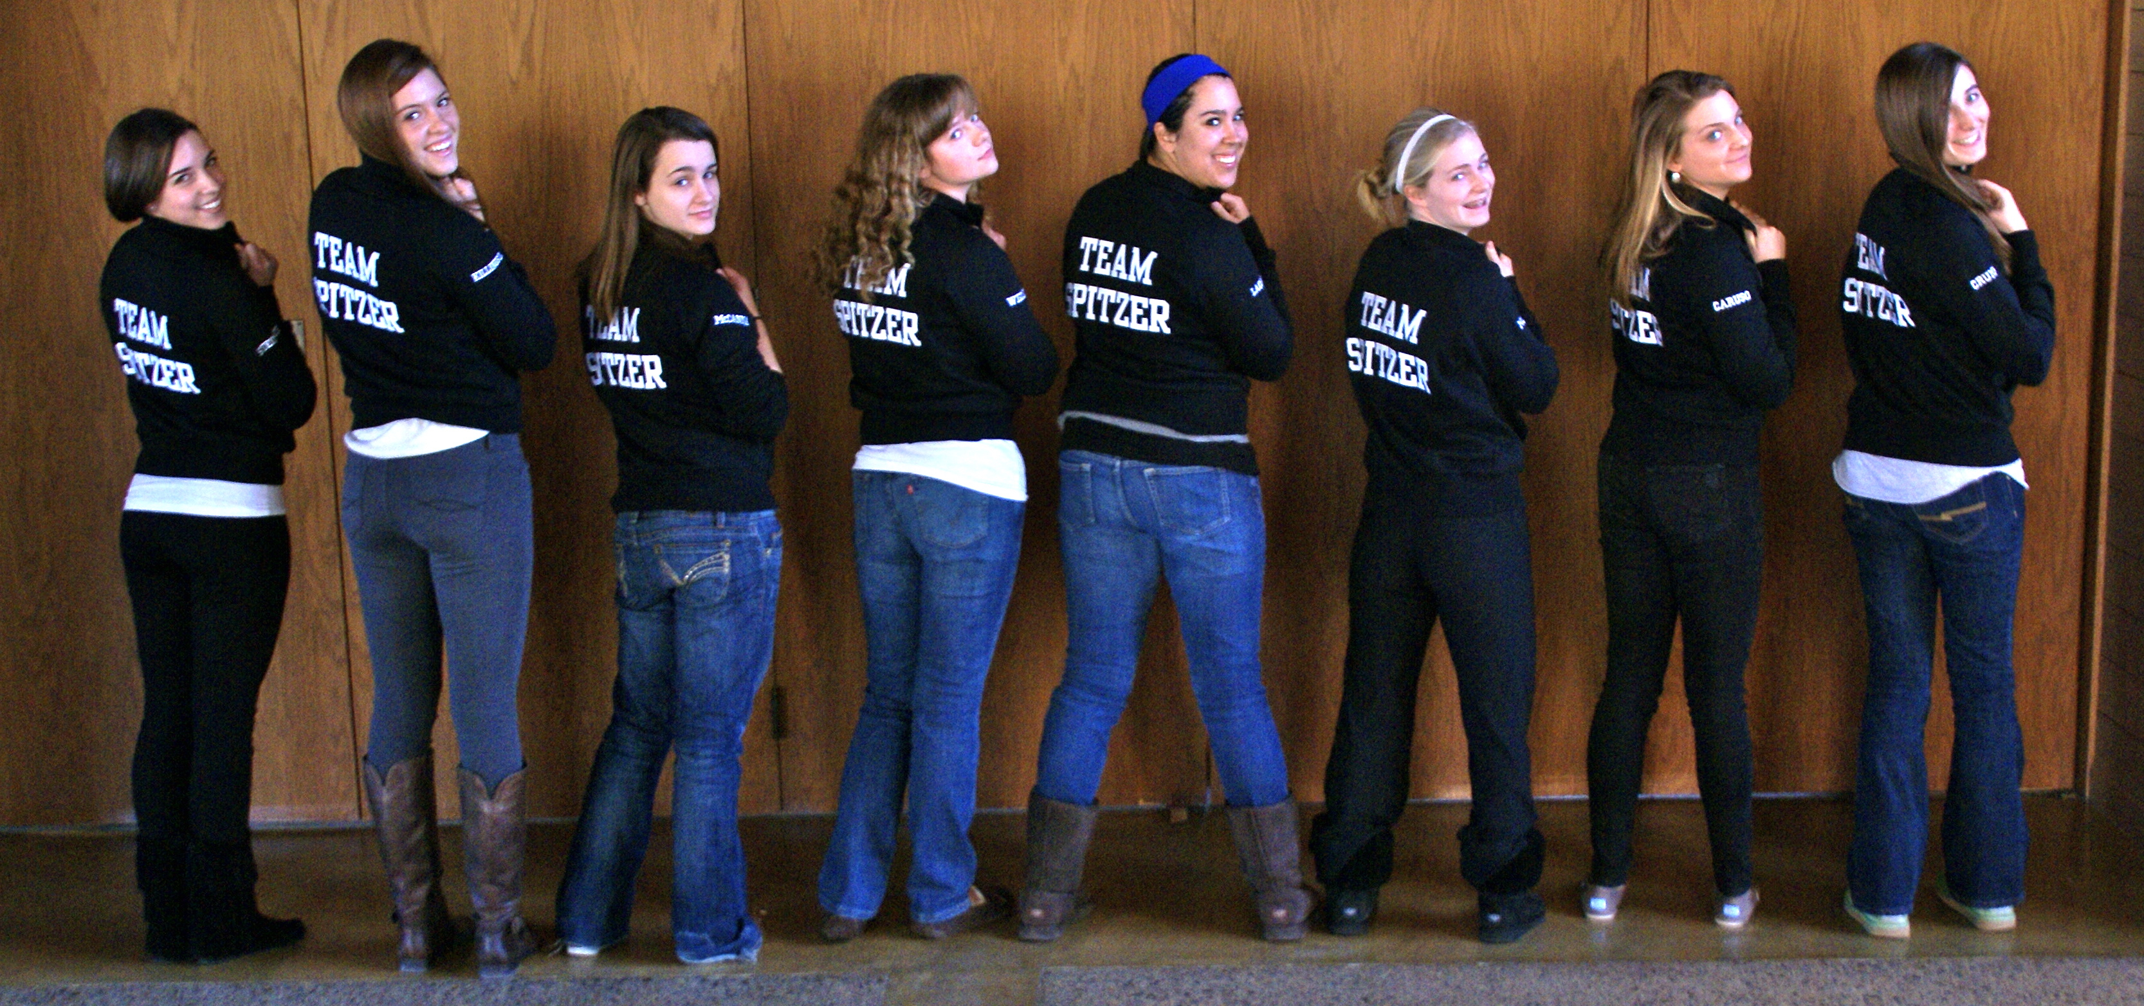
Changing the culture
3 went to AAS; 8 think differently about astronomy and science.

Slide 23
NITARP’s Future
Non-Science staff
Scientists
Educators
Can you help us with any of these?
I also need application and proposal reviewers; please let me know if you are interested!
$Money!
rebull@ipac.caltech.edu
Notes:
NEED SCI

Slide 24
Role(s) of Non-Science staff
Provides non-astronomer role models for STEM careers.
Provides additional help for scientist and mentor teacher.
You may be able to identify a specific need that you can fill – Russ Laher wrote APT, Aperture Photometry Tool, a Java-based application to do photometry. Now taking on a life of its own.
Not limited just to IPAC staff. May be limited space, depending on your needs/wants and ours.
Visits coming up! Come talk to me if you are interested in any aspect of helping with this.

