Slide 1
PODShell: Simplifying HPC in the Cloud Workflow
June 2011

Slide 2





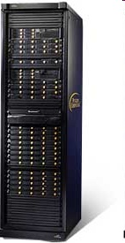

Penguin provides Linux HPC Solutions
Linux Systems
Cluster
Management Software
HPC as a Service - Penguin on Demand
Professional Services and Engineering
Servers
Workstations
HPC Clusters
Storage
Optimized for Linux
Ease of Management
Elastic Computing
Linux and Cluster Expertise
Intel® & AMD® Rackmount
Servers
Storage
Networking
Infrastructure
GPGPUs
Professional Workstations
On-demand environment
HPC ‘optimized’
Tiered ‘Pay-as-you-go’ pricing
Premium set-up and support services
Factory Integration
Onsite Installation
Training
Product Support
Software Support
Customized Service Engagements
Scyld ClusterWare™
Scyld TaskMaster™
Enterprise Linux
Compilers & Tools

Slide 3


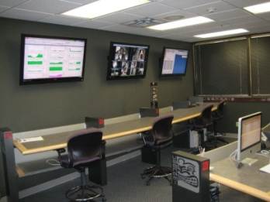
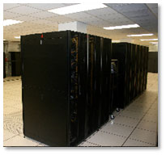
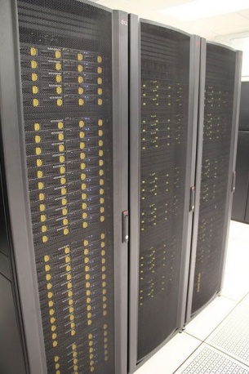
Software Product Line
Insight
Beoweb
Complete physical or virtual cluster management GUI
1:1 match with Scyld CW functionality
Hardware and workflow monitoring
Integrated log viewer for maintenance and diagnostics
Exposes Scyld CW functionality through a secure Web interface (https://)
Enables Web sites and applications to dynamically interact with a Scyld cluster
Dynamically present cluster and job status to users
Remote administrators/users
PODTools
Scyld ClusterWare
Convenient and secure method to submit jobs and data to POD
Automatically returns results when complete
Customize workflow through a scriptable interface
Generate ad hoc reports to see core hour and GB usage
Cluster management interface
Minimizes effort required to set-up, update and maintain a cluster
Guarantees consistency across all servers
Provides complete, tested and supported cluster software stack
HPC in the Cloud
On-premise systems
Notes:
Worldwide Cloud Access via Internet – GUI or command shell
Data movement – either Internet or POD Disk Caddy
Service – LifeScope analyses plus data storage (temporary or long-term)
Cost – Pay as you go + monthly account fee for your virtual server
Help? On-demand system administrators with LifeScope experience

Slide 4
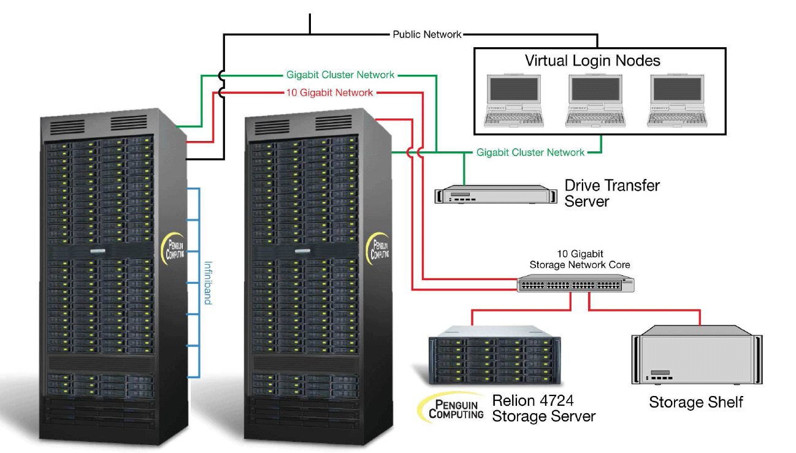
What is POD
On-demand HPC resource
Virtualized login node
Physical compute nodes
10 Gig direct attached NFS storage
Panasas HPPFS Available
GigE, 10Gig and
IB interconnect
Deployed in ‘scalable units’
1 to 480 cores available
on-demand
Internet (150Mb, burstable to 1Gb)

Slide 5
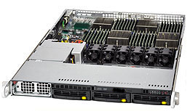

The New EDU POD
Owned and operated by the Penguin Computing on Demand staff
Hosted at Indiana University data center
AMD based compute infrastructure (shared environment)
  Altus 1804 servers
  48 cores per server (Opteron 6174 12C, 2.2 GHz)
  128GB, DDR3-1333 RAM per server
Lustre scratch file system (100TB)
QDR (40Gbps) Infiniband
Scyld Cloud Management System
Internet, Internet2 connectivity

Slide 6
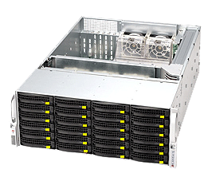
- Transferring data to/from POD
SCP
POD Disk Caddy (free, but the user pays the FedEx fees)
PODShell remote data staging (more on this later)
Upload bandwidth | Time to transfer 1GB | Time to transfer 50GB | Time to transfer 200GB
1 Mbps | 2 hours | 5 days | Take a 2 week vacation…
10 Mbps | 13 minutes | 11 hours | 2 days
50 Mbps | 3 minutes | 2 hours | 9 hours
150 Mbps | 53 seconds | 45 minutes | 3 hours
Dedicated Storage Node serves as a physical Login Node
User data transferred to POD on disks can be immediately available
User can have complete control over data transferred (software RAID, encryption, etc.)
Discounts apply to quarterly or yearly contracts

Slide 7
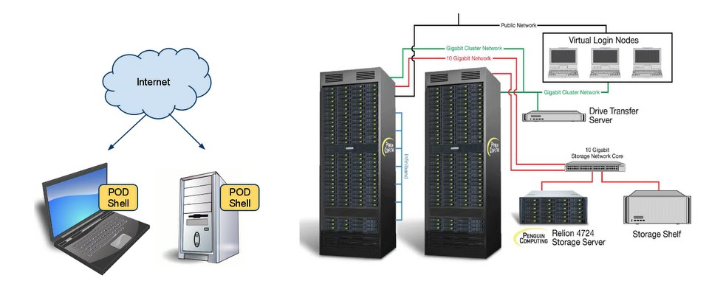
PODShell – overview
Combine the power of “submit”, “stage-in” and “stage-out” to create a single command that executes your entire workflow (application, data and job submission)
[root@mojito ~]# podsh submit --stagein=mydata:~/data --stageout=\~/myresults.log myjob.sub
Job Submitted successfully. Job ID: 1590
https:

Slide 8
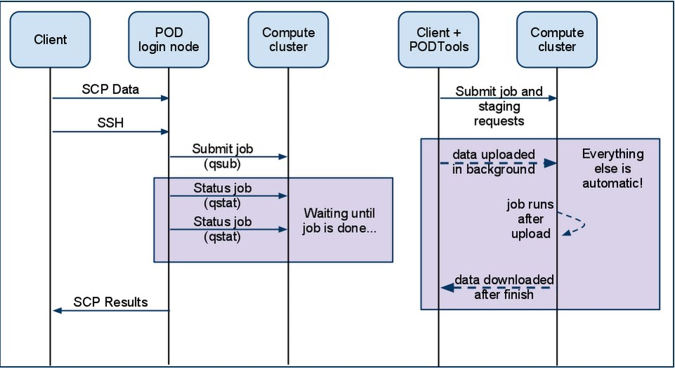
Comparing POD and PODShell
POD
POD Shell

Slide 9

How PODShell is set up at Caltech
Dedicated submission host with same libraries and compilation environment as POD
  Enables upload of binary compatible executables
Automated user creation based on LDAP attributes
Caltech/Penguin jointly managed
For help, contact help-hpc@caltech.edu
Caltech Submission Host

Slide 10
PODShell system requirements/compatibility
PODShell is installable on RHEL4 or RHEL5 systems (or CentOS)
If you don’t need binary compatibility
  Download RPMs for:
    PODTools (includes PODShell and PODReport)
    Python 2.6.5
    Python libraries/utilities
If you need binary compatibility
  Ask for your own Virtual Submission Host (VM)
    RPMs are already installed
RHEL6 support in Q3 2011
Internet access
Firewall open to ports 5000, 10000-10100

Slide 11
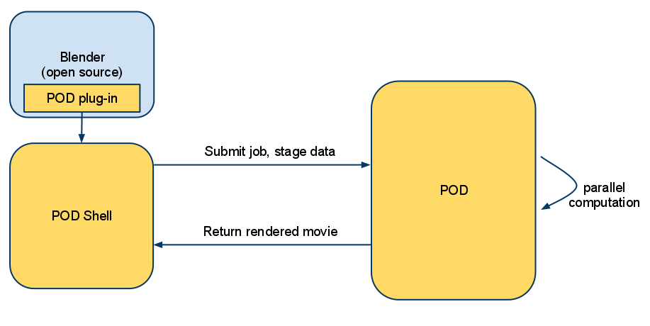
PODShell – it’s scriptable…
Since PODShell is a command line interface, it's scriptable
Allows automated workflows to POD without having to script SSH access and data transfers
Can be called from other programs with a “plug-in” capability
At SC10, we demoed a Blender plug-in built on PODShell that exported the scene to POD, rendered the frames, created the movie/animation, then copied result back to client machine

Slide 12
PODShell – security
PODShell communicates with POD using HTTPS and TCP
HTTPS used for everything except data staging
TCP sockets used for data staging
BOTH encrypted with TLSv1 (successor to SSLv3)
POD does not accept unencrypted connections with PODShell

Slide 13
PODShell – approximate Caltech prices
Service | Fee
Core hour rates | $0.20 (before Caltech discount)¹
On-demand storage | $0.20 per GB-month (before Caltech discount)
Optional storage server, 72 TB raw | $1600/month (user supplies disks)
Persistent login node | Not required!
Bandwidth | Included
Support | Included
Disk transfers | TBD
1. Does not include 3rd party application fees, if required.

Slide 14
PODShell – submitting jobs
POD supports two schedulers, TORQUE and SGE
PODShell acts as a “remote qsub”
Submit your job script with podsh submit
PODShell can submit to different schedulers from the command like with --sched= option:
[root@mojito ~]# podsh submit test.sub
Job Submitted successfully. Job ID: 1586
[root@mojito ~]# podsh submit --sched=SGE test.sub
Job Submitted successfully. Job ID: 1587

Slide 15
PODShell – data staging
PODShell can copy your data for you
  As part of a job, or independently
Use --stagein and/or --stageout options
Your job will automatically be held until stagein completes!
Stageout will not occur until after the job finishes
[root@mojito ~]# podsh submit --stagein=mydata.bin test.sub
Job Submitted successfully. Job ID: 1588
[root@mojito ~]# podsh submit --stageout=\~/myresults.log test.sub
Job Submitted successfully. Job ID: 1589

Slide 16
PODShell – checking job status
podsh status gives you output similar to qstat
Summary or detailed view, plus data staging information
[root@mojito ~]# podsh status
===========================================================================
Id Type State Job Name S Stage-in Stage-out
----------- -------- ------------ ------------ - ------------ ------------
361 COMPUTE COMPLETE N/A FINISHED NONE
1214 COMPUTE COMPLETE N/A FINISHED NONE
1373 COMPUTE COMPLETE N/A FINISHED FINISHED
1590 COMPUTE RUNNING test.sub R NONE NONE
[root@mojito ~]# podsh status 1590
ID: 1590
Type: COMPUTE
State: RUNNING
Join_Path = oe
fault_tolerant = False
exec_host = n86/0
Resource_List.neednodes = 1:ppn=1
Resource_List.walltime = 00:05:00

Slide 17
PODReport
PODReport is part of our PODTools “suite” of tools – which also include PODShell
Allows for custom usage reports for core-hours and storage
[root@mojito ~]# podreport -t cpu
Please note that CPU reports can take a minute or more to generate
Password:
CPU Report generated for user trhoden
================================================================================
Date range: 2011-05-26 to 2011-06-14
================================================================================
User Core-Hours
================================================================================
trhoden 0.04
[root@mojito ~]# podreport -t storage
STORAGE Report generated for user trhoden
================================================================================
Date range: 2011-05-26 to 2011-06-14
================================================================================
User Path Storage Used (GB)
================================================================================
trhoden /home/trhoden 0.59
trhoden /panasas/trhoden 0.0
=========
Total (GB): 0.59

