Slide 1
HPC in the Cloud with Penguin Computing on Demand ("POD")
June 2011

Slide 2
Agenda
(Brief) Introduction to Penguin Computing, Inc.
Introduction to POD
Case Studies
POD Shell

Slide 3
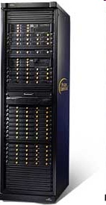
Penguin provides Linux HPC Solutions
Linux Systems
Cluster
Management Software
HPC as a Service - Penguin on Demand
Professional Services and Engineering
Servers
Workstations
HPC Clusters
Storage
Optimized for Linux
Ease of Management
Elastic Computing
Linux and Cluster Expertise
Intel® & AMD® Rackmount Servers
Storage
Networking
Infrastructure
GPGPUs
Professional Workstations
On-demand environment
HPC ‘optimized’
Tiered ‘Pay-as-you-go’ pricing
Premium set-up and support services
Factory Integration
Onsite Installation
Training
Product Support
Software Support
Customized Service Engagements
Scyld ClusterWare™
Scyld TaskMaster™
Enterprise Linux
Compilers & Tools

Slide 4
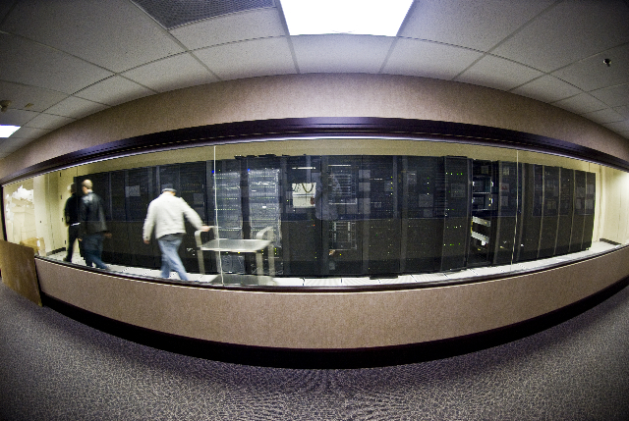
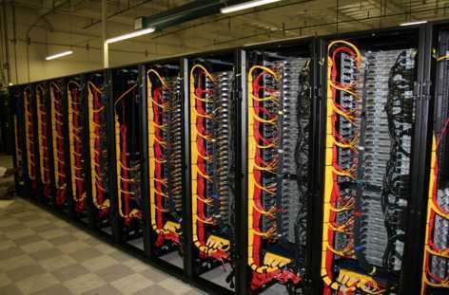
Large Cluster Example: Georgia Institute of Technology
Center for the Study of Systems Biology
10,000+ AMD cores
53+ TFLOPS
300+ TB of storage
Top 100 ranking
Notes:
Areas of research: Ligand (small molecule) docking to proteine – Development of tools that predict protein structure and function from DNA sequence

Slide 5
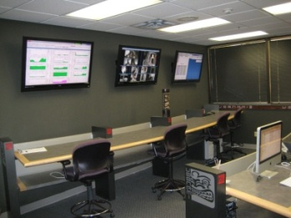
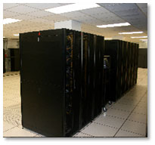
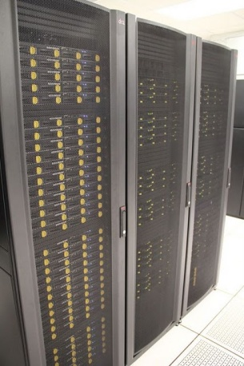
Software Product Line
Insight
Beoweb
Complete physical or virtual cluster management GUI
1:1 match with Scyld CW functionality
Hardware and workflow monitoring
Integrated log viewer for maintenance and diagnostics
Exposes Scyld CW functionality through a secure Web interface (https://)
Enables Web sites and applications to dynamically interact with a Scyld cluster
Dynamically present cluster and job status to users
Remote administrators/users
PODTools
Scyld ClusterWare
Convenient and secure method to submit jobs and data to POD
Automatically returns results when complete
Customize workflow through a scriptable interface
Generate ad hoc reports to see core hour and GB usage
Cluster management interface
Minimizes effort required to set-up, update and maintain a cluster
Guarantees consistency across all servers
Provides complete, tested and supported cluster software stack
HPC in the Cloud
On-premise systems
Notes:
Worldwide Cloud Access via Internet – GUI or command shell
Data movement – either Internet or POD Disk Caddy
Service – LifeScope analyses plus data storage (temporary or long-term)
Cost – Pay as you go + monthly account fee for your virtual server
Help? On-demand system administrators with LifeScope experience

Slide 6
Introduction to POD
What is POD
Is POD Cloud Computing?
How POD compares/contrasts to Amazon's EC2
The new EDU POD
Setting up your account
Transferring data to/from POD
Setting up your environment
Running jobs
GPU computing on POD
Running your software
Checking your usage and storage (PODReport)
POD's fee structure

Slide 7
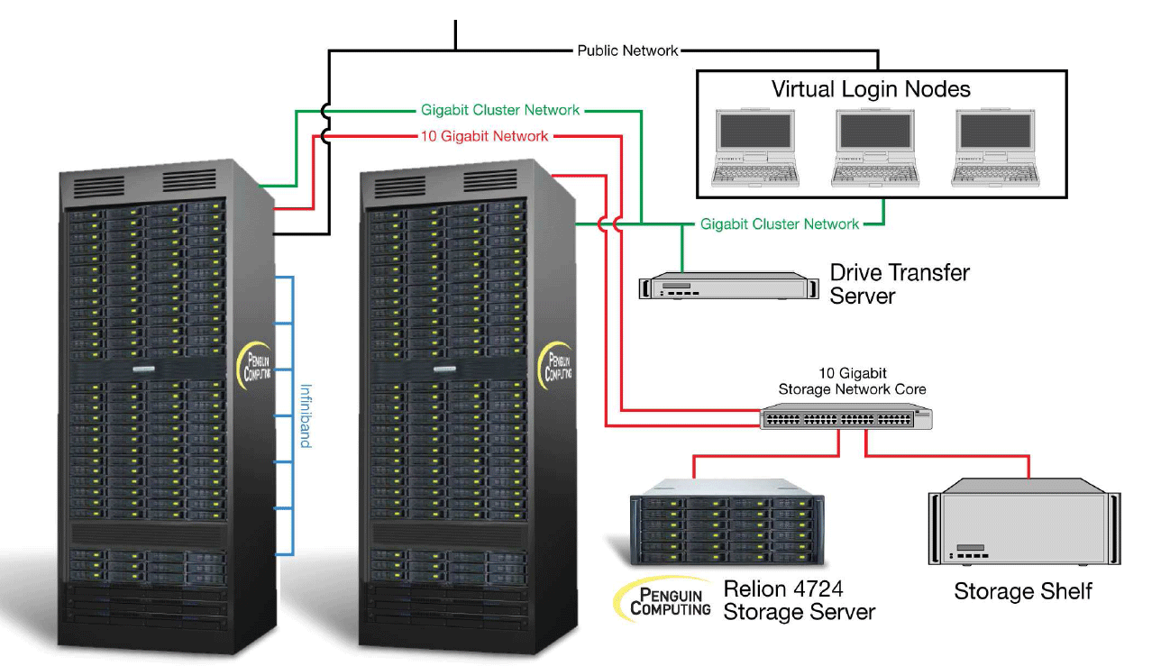
What is POD
On-demand HPC resource
Virtualized login node
single core
2GB RAM
(typical, greater capacities available)
Physical compute nodes
2.67GHz Xeon processors
8 cores per processor
4GB / core DDR2 RAM
1TB scratch per compute node
10 Gig direct attached NFS storage
Panasas HPPFS Available
GigE, 10Gig and IB interconnect
Deployed in ‘scalable units’
1 to 480 cores available on-demand
Internet (150Mb, burstable to 1Gb)

Slide 8
POD usage highlights
5 million commercial jobs in 2010
Users range from grad students to large financial institutions
Highly variable utilization, but capacity designed to minimize (eliminate) queues
Utilization characteristic of a variety of job types
Secure computing
end-to-end data encryption available
users not shared across server boundaries

Slide 9
Is POD Cloud Computing
Depends on your definition of “cloud computing”
Wikipedia: “Cloud computing refers to the logical computational resources (data, software) accessible via a computer network, rather than from a local computer.”
Based on Wikipedia, yes.
InfoWorld: “Some analysts and vendors define cloud computing narrowly as an updated version of utility computing: basically virtual servers available over the Internet. Others go very broad, arguing anything you consume outside the firewall is ‘in the cloud,’ including conventional outsourcing.”
Based on InfoWorld narrow definition, not really.
SearchCloudComputing.com: “A cloud service has three distinct characteristics that differentiate it from traditional hosting. It is sold on demand, typically by the minute or the hour; it is elastic -- a user can have as much or as little of a service as they want at any given time; and the service is fully managed by the provider (the consumer needs nothing but a personal computer and Internet access).”
Based on SearchCloudComputing.com, yes.

Slide 10
POD – HPC as a Service
Definition | Examples | HPC Retail Price Point
Hybrid (virtual and physical) HPC cloud infrastructure plus HPC services and support | Penguin Computing | $0.20/physical core hour * $0.20/GB-month
Virtualized infrastructure plus Web services to deliver cloud computing | AWS | $1.60 per virtual server hour (CCI)
Outsourced storage, hardware, servers and networking | Rackspace | $0.96 per server hour (monthly contract)
Servers and network for rent | Numerous … | $0.08 per server hour and up (monthly contract)
HPC as a Service
Platform as a Service
Infrastructure as a Service
Hardware as a Service
* typically we see only 50 to 70% actual core utilization on HPC servers so the actual cost of Amazon, Google or Microsoft is 1.4 to 2 times the core hour rate shown

Slide 11
Comparing POD and EC2
POD
Description |  |  | Comments
High-speed Intel compute nodes | ✓ | ✓ | POD is bare-metal computing
Fast access to local storage | ✓ | ✓ | POD does not charge to move data
GPU enabled servers | ✓ | ✓
Cluster software stack included? | ✗ | ✓ (included) | EC2 requires that you partner with a 3rd party
HPC expertise? | ✗ | ✓ (included) | Penguin has dedicated HPC customer support
Other compute nodes available | ✗ | ✓ | We have 2.6 GHz Harpertown, 2.93GHz Nehalem, 2.93 GHz Westmere, 2.3 GHz AMD MC 12C – more are added every month
Customized Linux compute environment? | Available | ✓ (included) | EC2 instances must be created by the user
Bill by the core hour? | ✗ | ✓ | EC2 billed by the server hour (rounded up)
Data locality? | ✗ | ✓ | No guarantee where Amazon’s data is stored
Troubleshooting? | $$$ | ✓ (included) | HPC applications are not plug ‘n play
Dynamically scalable? | Limited | 1-480 cores on-demand | EC2 provides up to 8 CCIs, but you can request more…

Slide 12
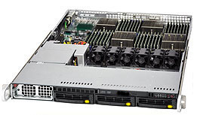
The New EDU POD
Owned and operated by the Penguin Computing on Demand staff
Hosted at Indiana University data center
AMD based compute infrastructure (shared environment)
Altus 1804 servers
48 cores per server (Opteron 6174 12C, 2.2 GHz)
128GB, DDR3-1333 RAM per server
Lustre scratch file system (100TB)
QDR (40Gbps) Infiniband
Scyld Cloud Management System
Internet, Internet2 connectivity

Slide 13
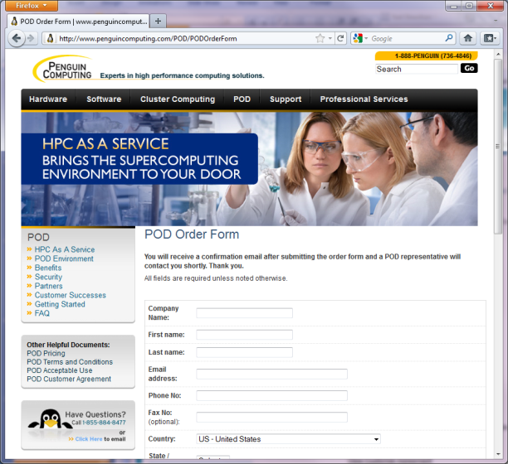
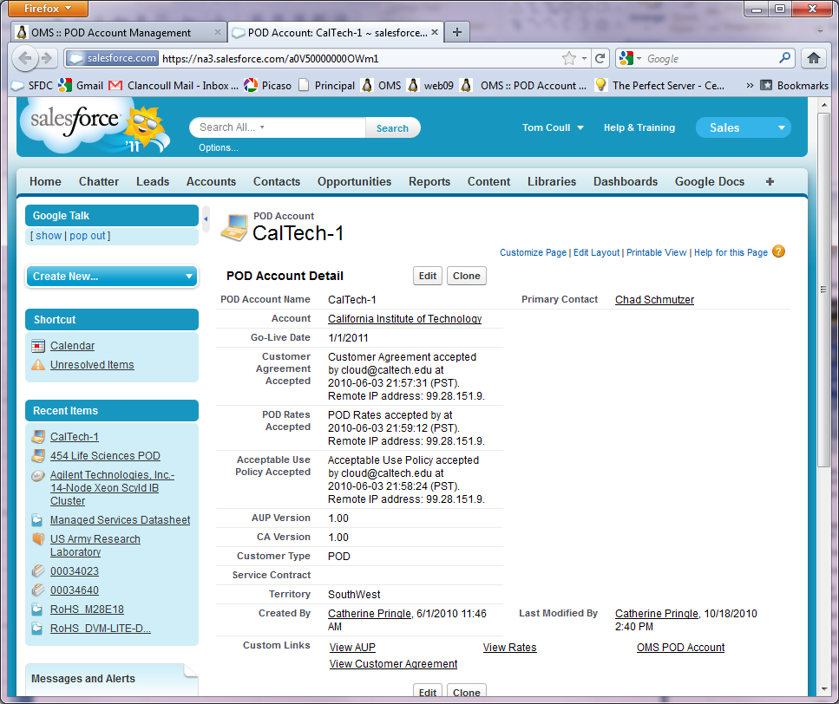
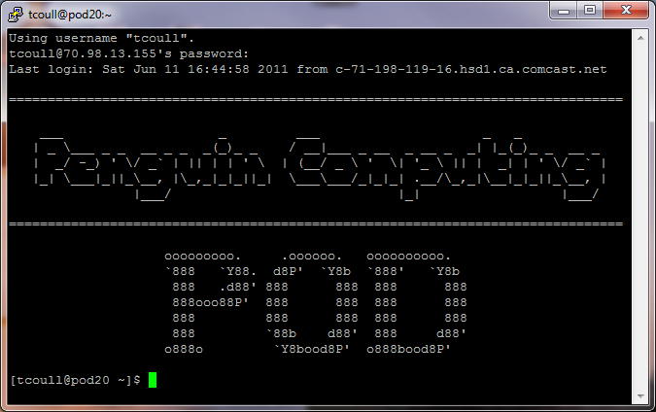
Setting up your POD account
Click the link to the POD Order Form
Provide the Services and Infrastructure you think you need
A POD Account Representative will email you to review your requirements and establish your POD account
Log into your POD Portal and review/accept the agreements and fees
POD will contact you for your IP address and open the firewall
You can now log in…

Slide 14
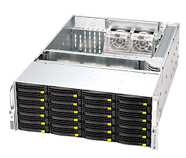
- Transferring data to/from POD
SCP
POD Disk Caddy (free, but the user pays the FedEx fees)
PODShell remote data staging (more on this later)
Upload bandwidth | Time to transfer 1GB | Time to transfer 50GB | Time to transfer 200GB
1 Mbps | 2 hours | 5 days | Take your 2 week vacation…
10 Mbps | 13 minutes | 11 hours | 2 days
50 Mbps | 3 minutes | 2 hours | 9 hours
150 Mbps | 53 seconds | 45 minutes | 3 hours
Dedicated Storage Node serves as a physical Login Node
User data transferred to POD on disks can be immediately available
User can have complete control over data transferred (software RAID, encryption, etc.)
Discounts apply to quarterly or yearly contracts

Slide 15
Setting up your environment
Preparing your Application
Upload (scp) your custom code or download (wget) OpenSource code
Configure the code with PREFIX=$HOME/projectname
All $HOME paths are available on compute nodes
Compiling your Application
Use available env-modules to load libraries that might be necessary to compile (cuda, openmpi, etc)
To see available modules: module avail
To load an available module (example: GNU OpenMPI): module load openmpi/gnu
Env-modules will automatically set PATH, LD_LIBRARY_PATH and MANPATH to load the proper locations.
For instance, In the case of module load openmpi/gnu, you will be provided with OpenMPI's mpicc, mpif90, miprun, etc.
Prepare a Job Script to Run your Application
Write a PBS or SGE .sub file that will run your application
Use env-module commands inside job scripts to load things like OpenMPI's mpirun
Job script examples are provided upon request

Slide 16
Running jobs
Submission: How to request nodes, connectivity, etc.
To see node availability: pbsnodes
To see queue availability: qstat -q
Submission: How to request notifications
Either with qsub or inside the .sub script:
#PBS -M emailaddress@yourdomain.com
#PBS -m abe
Submission: Specifying environment variables
Not sure what you are looking for here - please explain.
Submission: Setting dependencies
Job dependencies are configured using qsub -W. To make job 2 dependent on job 1:
qsub job1.sub
1.scyld
qsub -W depend=afterok:1.scyld job2.sub

Slide 17
Running jobs (continued)
Submission: Submitting your job
Use qsub to submit your job script
qsub <jobscript.sub>
Runtime: Check job status
Use qstat to check your job status.
qstat
qstat –an
Using beostatus remote
Runtime: Deleting a job
Use qdel to delete a job that is Running or in Queue
qdel <jobid>

Slide 18
GPU computing on POD
POD's CUDA-enabled nodes have NVidia C1060s (or later) installed. To request a CUDA-enabled node, request your job with the 'C1060' PBS node attribute. If any type of card is sufficient, you can use the 'cuda' attribute.
For instance:
#PBS -l nodes=1:ppn=8:C1060 Or:
qsub -l nodes=1:ppn=8:cuda

Slide 19
Running your own software
GCC, CUDA and OpenMPI compilers are provided in the POD environment so that customer can install applications in $HOME, which is shared out to the compute nodes. For example, to load OpenMPI's mpicc, mpif90 and mpiCC, use the command: module load openmpi/gnu
If applications need to be shared amongst multiple users, POD administrators can install the application in a shared /opt space, which is also mounted by compute nodes
Applications installed in /opt for groups of users are loaded into your shell environment using the module load command. For example: module load R
Commercial applications like Matlab and Lumerical that require license servers can be configured to request licenses from your license server
Alternatively, POD may also host your license server if permissible by the vendor's license agreements

Slide 20
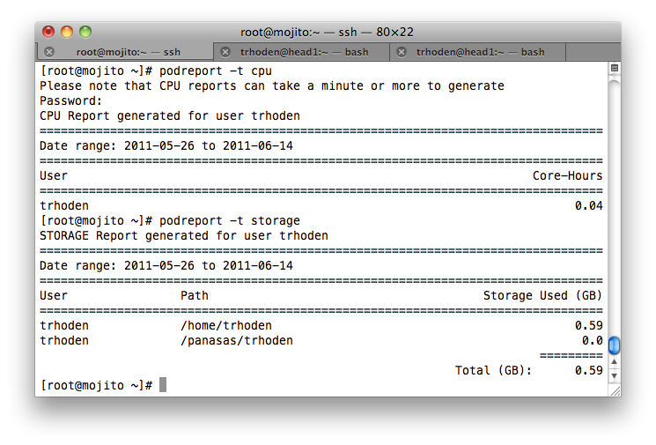
Checking your usage and storage (PODReport)
Query core hour usage of completed jobs
Query storage utilization
Custom report dates
Current billing-cycle
Previous billing cycle
Group reports

Slide 21
POD Offerings and Prices
Service | Fee
Core hour rates | $0.10 to $0.20 pch (plus application uplift)
Dedicated servers | $800 to $1,650 per month
On-demand Storage and Fast-access Scratch Storage | $200 per TB-month
Combination Login/Storage Node (48TB raw) | $1600/month (customer supplies disks)
Persistent Login Node | Virtual Machine - $79.95/month Physical Server - $290/month
Bandwidth | Included
Support | Included
Disk transfers | Included

Slide 22
Case Study: Dolby Laboratories
Develop encoding IP
HDTV, Blu Ray etc.
Scalable compute intensive algorithms
Iterative development process
Faster turnaround of encoding jobs ⇒ Increased development efficiency
Massive amounts of ‘raw’ data as encoding input
Limited ‘in-house’ resources and admin capabilities
Uneven workload over time
“The use of POD is contributing significantly to making our development process more efficient”
Gopi Lakshminarayanan, Director of Software Development
The POD Solution
Migration of scalable algorithms to POD
Scale out to 100 cores per job
Data management
‘Raw’ data upload through POD’s caddy service
Processed encoded data downloaded
Reduced job runtime from 2 days ⇒ 2 hours

Slide 23
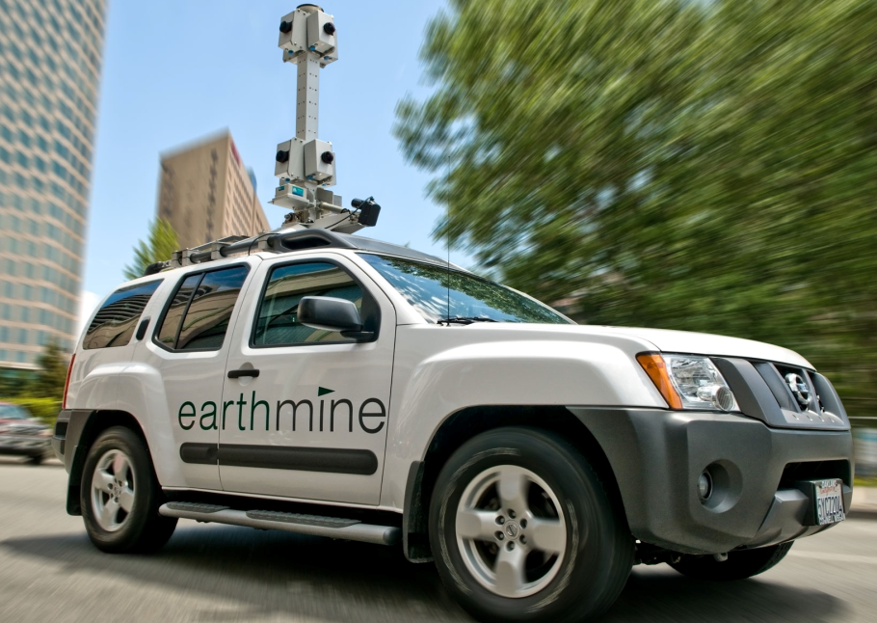
Case Study: Earthmine Inc.
Specialized in 3D street level imagery
Library of 3D street level data/API’s for web applications
Allows for application integration of interactive street level maps
Images spatially accurate
Eight 2D images per location need to be processed to create accurate 3D ‘image’
Image processing computationally expensive
Uneven workload dependent on # of data collection vehicles
Limited in-house resources for data processing
“Overall, the experience has been great. POD is fast, reliable, and works as described. In particular, POD has provided excellent support and Penguin has gone out of its way many times to accommodate our requests for technical help and to meet our fast-changing needs.“
John Ristevski,
CTO Earthmine
The POD Solution
POD provides ‘overflow’ capacity
Submission of up to 40,000 jobs per day, 300,000 per month
Integration with Amazon EC2 for Earthmine cloud services

Slide 24
Case Study: Cofactor Genomics
Notes:
“When Ozzy and I began to do the weekly 'Dr Ozzy' column for The Sunday Times -- now also in Rolling Stone – I got the idea to ask [Knome] about possibly sequencing Ozzy's genome as a one-off article. It snowballed from there,” says Ayres.
Osbourne, who described himself as “a rock star, not Brain of Britain,” initially needed some convincing to go along. “The only ‘genome’ I’d ever heard of was the kind you find at the bottom of the garden with a little white beard and a pointy red hat,” he wrote. “The only Gene I know anything about is the one in Kiss.” But he came around. After all, he wrote, “Given the swimming pools of booze I’ve guzzled over the years — not to mention all the [drugs] . . . there’s really no plausible medical reason why I should still be alive. Maybe my DNA could say why.”
Supporting Osbourne was a tight three-piece outfit. The sequencing was conducted at St Louis-based Cofactor Genomics, performed on the Life Technologies SOLiD 4 platform, which also assisted in the early bioinformatic analysis. The final genomic interpretation and presentation was handled by Knome.
Cofactor generated 39 Gigabases of Osbourne’s sequence (13X coverage) over about three weeks using both long-insert mate pairs and fragment reads. (Human genomes are usually sequenced to 30X coverage, but Osbourne’s sequence was time sensitive.) About 70 percent of the DNA reads were mappable, which he calls “very good.”
Houston-based Matt Dyer has a field-based position with Life Technologies, supporting Midwest users of the SOLiD platform on issues including experimental design and data analysis. “Jarret [Glasscock, Cofactor CEO] contacted me, and said they needed some help for an urgent, once-in-a-lifetime project,” says Dyer, who didn’t need to be asked twice. “I’m a big fan of biology and bioinformatics -- though not Black Sabbath necessarily!” he says.
Because of the urgency of the project, Dyer used cloud resources offered by Penguin Computing (Penguin On Demand). After Cofactor uploaded the sequence data to the cloud, Dyer logged on and took over, with immediate access to thousands of compute nodes. No read filtering was performed. “We don’t do any filtering -- we let the mapping do the filtering,” says Dyer. “If the read is bad, it won’t map to the reference.”
Knome took the assembled sequence and ran it through its internal analysis pipeline, producing a richly annotated genome and a set of interesting DNA variants to select for further analysis. Knome’s director of research, Nathan Pearson, then flew to the UK recently to deliver Osbourne’s results in person, but not before he had conferred with Osbourne’s wife, Sharon, a judge on America’s Got Talent.
“We thought about what it is that makes Ozzy unique,” says Conde. “Given he’s a musician and he’s been diagnosed with a parkinson’s-like tremor, we looked for things associated with nerve function. We found a couple of interesting things – but as Nathan says, ‘We found smoke but no fire.’ There was no ‘Ozzy variant’ – that goes without saying.” The interesting variants lie in the genes TTN (associated with deafness and Parkinsonism) and CLTCL1 (brain chemistry). They might merit further study, Conde suggests.
Knome also found a novel variant in the ADH4 alcohol metabolizing gene, which might explain Osbourne’s legendary high tolerance for alcohol. Ironically, Osbourne is highly sensitive to caffeine, and has the genetic variant to prove it. Another interesting variant was in the COMT gene – Osbourne carries two versions of the gene that have been associated with “worrier” and “warrior” behavioral tendencies.
Another interesting tidbit was the ability to screen Osbourne’s genome for traces of Neanderthal DNA, following new evidence of ancient inter-breeding between humans and Neanderthals emerging from the Neanderthal genome study. “We were looking for matches for long segments unique to Neanderthals, and found a couple of pretty long segments [in Osbourne’s genome],” says Conde. “But George Church [Knome co-founder] has 3x as much matching segment.”

Slide 25
Hard Rock, Life Science and POD
Ozzy Osbournes genome analyzed on SOLiD 4
Cofactor generated 39 Gigabases (13 x coverage)
Full sequence data shipped to POD on hard drive
Secondary Analysis: Bioscope mapping-pairing engine on POD used for mapping sequence to reference (HG18)
Tertiary Analysis: SNPs and small indels identified and analyzed by Bioscope pipeline and analyzed by Knome
Results
Novel variant in the ADH4 alcohol metabolizing gene
Variant for caffeine sensitivity
variants in TTN (deafness and Parkinsonism) and CLTCL1 (brain chemistry)
Detailed coverage at http://www.bio-itworld.com
Notes:
Reporter Chris Ayres who had co-authored Ozzy’s memoires ‘I am Ozzy’ accidentally ran into Knome CEO Jorge Conde. Knome was the first company to offer whole genome sequencing for individuals.
Ayres was also working with Ozzy on a weekly column Dr. Ozzy for the Sunday times. Ayres had the idea was to sequence Ozzy’s genmome and cover the results.
“The only ‘genome’ I’d ever heard of was the kind you find at the bottom of the garden with a little white beard and a pointy red hat,” he wrote. “The only Gene I know anything about is the one in Kiss.” But he came around. After all, he wrote, “Given the swimming pools of booze I’ve guzzled over the years — not to mention all the [drugs] . . . there’s really no plausible medical reason why I should still be alive. Maybe my DNA could say why.

Slide 26
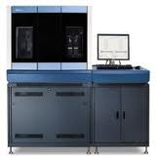
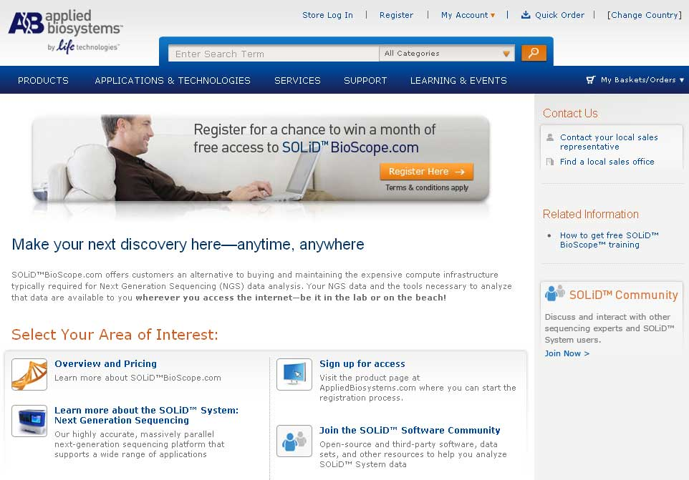
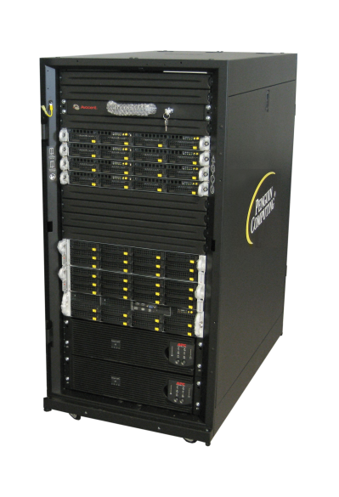
Case Study
“Penguin provides the cluster management technology and expertise to support our next generation gene sequencer”
- Tim Burcham, Vice President
Solution Provided
Life Technologies is a world leader in gene sequencing systems with 250 customers world-wide, growing at 100% per year
Life Tech’s on-demand SaaS solution LifeScopeCloud.com is hosted on POD
Penguin provides the first CE Mark certified BioScope cluster appliance world-wide
Each Life Technologies customer can generate 1TB of gene sequencing data per week per machine.

Slide 27
PODShell (live demonstrations)
What is POD Shell
How it is set up at Caltech
Submitting Jobs
Switching between TORQUE and SGE
Data Staging
Scripting / workflow
Security
Report examples

Slide 28
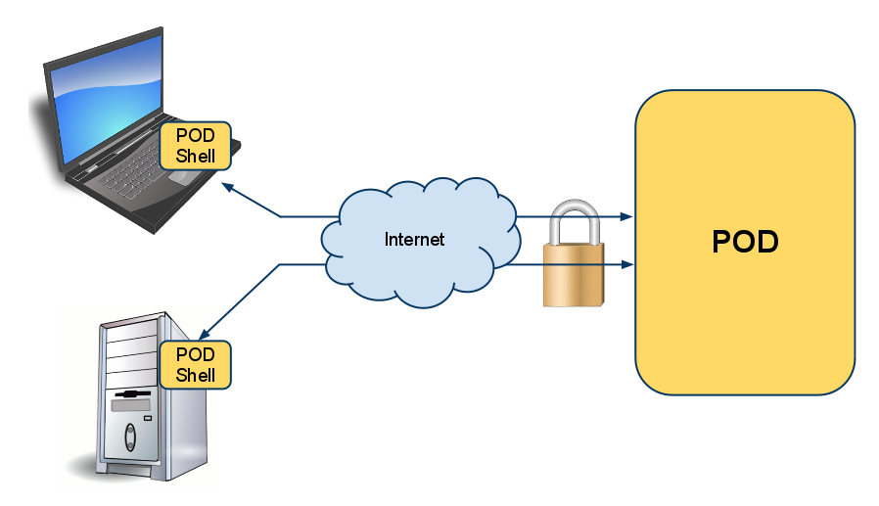
PODShell – overview
Secure, remote access to POD
Submit jobs directly to POD without SSH/SCP
Copy data to/from POD, either as part of a compute job or independent (data staging)

Slide 29
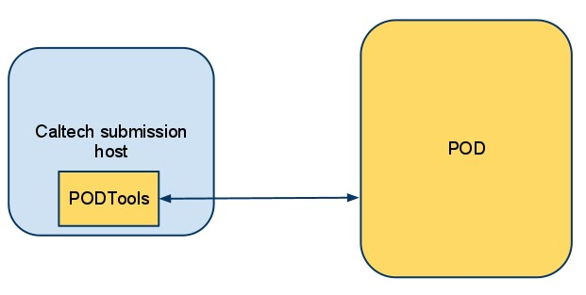
How PODShell is set up at Caltech
Dedicated submission host with same libraries and compilation environment as POD
Enables upload of binary compatible executables
Automated user creation based on LDAP attributes-
Caltech/Penguin jointly managed

Slide 30
PODShell system requirements/compatibility
PODShell is installable on RHEL4 or RHEL5 systems (or CentOS)
We distribute RPMs for:
PODTools (includes PODShell and PODReport)
Python 2.6.5
Python libraries/utilities
RHEL6 support in Q3 2011
Internet access
Firewall open to ports 5000, 10000-10100

Slide 31
PODShell – submitting jobs
POD supports two schedulers, TORQUE and SGE
PODShell acts as a “remote qsub”
Submit your job script with podsh submit
PODShell can submit to different schedulers from the command like with --sched= option:
[root@mojito ~]# podsh submit test.sub
Job Submitted successfully. Job ID: 1586
[root@mojito ~]# podsh submit --sched=SGE test.sub
Job Submitted successfully. Job ID: 1587

Slide 32
PODShell – data staging
PODShell can copy your data for you
As part of a job, or independently
Use --stagein and/or --stageout options
Your job will automatically be held until stagein completes!
Stageout will not occur until after the job finishes
[root@mojito ~]# podsh submit --stagein=mydata.bin test.sub
Job Submitted successfully. Job ID: 1588
[root@mojito ~]# podsh submit --stageout=\~/myresults.log test.sub
Job Submitted successfully. Job ID: 1589

Slide 33
PODShell – data staging (continued)
Combine the power of stagein and stageout to create a single command that executes your entire workflow.
Without POD Shell
SCP Data from local machine to POD
SSH to host and submit job
Status job from SSH session
Or wait for job email
Once job is completed, SCP data from POD to your local machine
With POD Shell:
All steps accomplished by one command
[root@mojito ~]# podsh submit --stagein=mydata:~/data --stageout=\~/myresults.log myjob.sub
Job Submitted successfully. Job ID: 1590

Slide 34
PODShell – checking job status
podsh status gives you output similar to qstat
Summary or detailed view, plus data staging information
[root@mojito ~]# podsh status
===========================================================================
Id Type State Job Name S Stage-in Stage-out
----------- -------- ------------ ------------ - ------------ ------------
361 COMPUTE COMPLETE N/A FINISHED NONE
1214 COMPUTE COMPLETE N/A FINISHED NONE
1373 COMPUTE COMPLETE N/A FINISHED FINISHED
1590 COMPUTE RUNNING test.sub R NONE NONE
[root@mojito ~]# podsh status 1590
ID: 1590
Type: COMPUTE
State: RUNNING
Join_Path = oe
fault_tolerant = False
exec_host = n86/0
Resource_List.neednodes = 1:ppn=1
Resource_List.walltime = 00:05:00

Slide 35
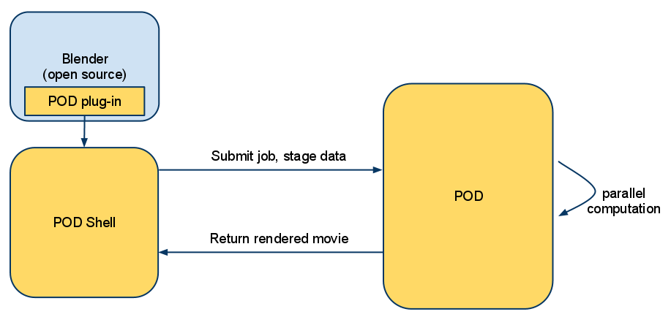
PODShell – it’s scriptable…
Since PODShell is a command line interface, it's scriptable
Allows automated workflows to POD without having to script SSH access and data transfers
Can be called from other programs with a “plug-in” capability
At SC10, we demoed a Blender plug-in built on PODShell that exported the scene to POD, rendered the frames, created the movie/animation, then copied result back to client machine

Slide 36
PODShell – security
PODShell communicates with POD using HTTPS and TCP
HTTPS used for everything except data staging
TCP sockets used for data staging
BOTH encrypted with TLSv1 (successor to SSLv3)
POD does not accept unencrypted connections with PODShell

Slide 37
PODReport
PODReport is part of our PODTools “suite” of tools – which also include PODShell
Allows for custom usage reports for core-hours and storage
[root@mojito ~]# podreport -t cpu
Please note that CPU reports can take a minute or more to generate
Password:
CPU Report generated for user trhoden
================================================================================
Date range: 2011-05-26 to 2011-06-14
================================================================================
User Core-Hours
================================================================================
trhoden 0.04
[root@mojito ~]# podreport -t storage
STORAGE Report generated for user trhoden
================================================================================
Date range: 2011-05-26 to 2011-06-14
================================================================================
User Path Storage Used (GB)
================================================================================
trhoden /home/trhoden 0.59
trhoden /panasas/trhoden 0.0
=========
Total (GB): 0.59

