Slide 1
The NASA Star and Exoplanet Database (NStED) Periodogram Service
Moira Regelson
with G. Bruce Berriman, David Ciardi, Peter Plavchan,
John Good and Amy Beekley
GRITS June 11, 2010

Slide 2
Overview
Looking for planets using time series data
Radial velocity
Transit detection
Extracting periodic signals
Periodograms at NStED

Slide 3
Looking for planets: Radial Velocity
“Wobbles” in the radial velocity measurements over time can indicate a planet
http://www.howstuffworks.com/planet-hunting2.htm
Most of the known extra-solar planets were detected with this method

Slide 4
Looking for planets: Transits
Periodic dip in intensity of a star
May occur when a planet passes (“transits”) in front of the star
http://en.wikipedia.org/wiki/File:Planetary_transit.svg
Many surveys for transiting planets
Space Missions: Kepler, CoRoT
Ground-based Transit Search Programs: TReS, HAtNet, XO, …
200,000 light curves at NStED

Slide 5
Extracting periodic signals
In both cases, looking for repeating variations over time
Apply transform techniques to calculate the significance of different periods
Note that with astronomical data, we cannot assume even time-sampling
Plot of power at each period called a “Periodogram”

Slide 6
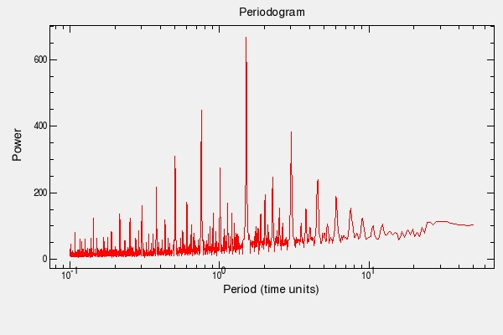
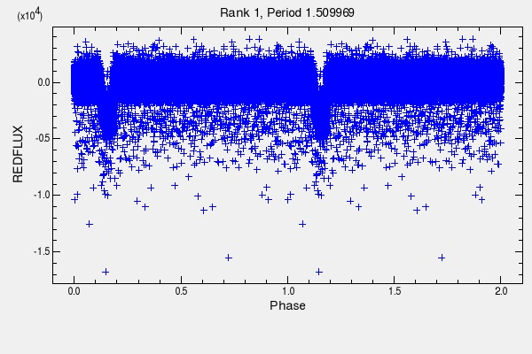
Periodograms at NStED
Algorithms
Examples
Implementation
Performance
Release Plan
Periodogram for CoRoT-1.
Phased Light Curve for CoRoT-1 showing the transiting exoplanet signal

Slide 7
Periodograms at NStED: Algorithms
Lomb-Scargle
Approximation of Fourier transform for unevenly sampled data, so best for sinusoidal variations (e.g. radial velocity)
Horne and Baliunas, Ap J, 302,757 (1986); Scargle. Ap J, 263,835 (1982)
Box-fitting Least Squares
Optimized for "box"-like signals (e.g. transiting planets)
Kovacs, Zucker, and Mazeh, A&A, 391, 377 (2002)
Plavchan
Binless phase-dispersion minimization algorithm that identifies periods with coherent phased light curves (i.e., least “dispersed”) regardless of signal shape
Plavchan, Jura, Kirkpatrick, Cutri, and Gallagher. ApJS, 175,19 (2008)

Slide 8
Periodograms at NStED: Example 1
Periodogram and phased curve for GJ 876 radial velocity curve

Slide 9
Periodograms at NStED: Example 2
Periodogram and phased curve for HAT-P-4 light curve

Slide 10
Periodograms at NStED: Implementation
Written in C
Parallelized on 128-processor cluster of Dell 1950 servers
Processing of each period in output space is independent of all others
Front end divides jobs into sets of periods, distributes to processors on the cluster, combines results when complete
Performance improvement approximately 100x relative to serial processing

Slide 11
Periodograms at NStED: Performance
Data Points | Approximate Run Time (one processor) |  |  | Periods Sampled
 | L-S | BLS | Plavchan
1,000 | 2 s | 0.5 s | 3 s | 10,000
10,000 | 20 s | 12 s | 36 s | 10,000
10,000 | 3.5 m | 2 m | 6 m | 100,000
420,000 | 9 h | 4 h | 41 h | 420,000
Processing time with L-S algorithm for a 422,952-point CoRoT light curve reduced from ~560m on a single processor to under 5m on the cluster

Slide 12
Periodograms at NStED: Release Plan
Release | Date | Service
1 | 6/18/10 | Web interface to Kepler light curves
2 | 8/15/10 | Program Interface to CoRoT light curves Web interface to transit data sets at NStED
3 | 11/1/10 | Bulk processing service

Slide 13
Summary
Tool for rapidly finding periods in time series
Undergoing final testing and validation
Releases planned during Summer and Fall

Slide 14
Questions?

Slide 15
Thanks!
Bruce Berriman
David Ciardi
Peter Plavchan
John Good
Amy Beekley
Meca Lynn
Anastasia Laity
Douglas L. McElroy
Mark Abajian
Steve Berukoff
Kaspar von Braun
Stephen Kane
NStED

