Slide 1
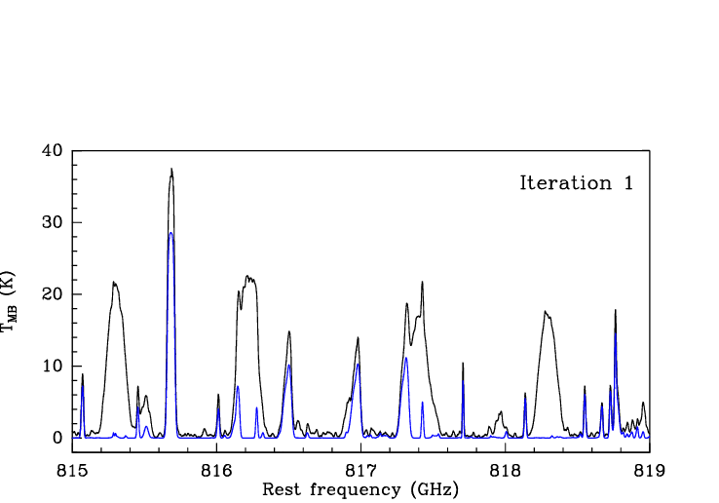
IPAC's Spectral Deconvolution Tool - Steve Lord
Unfolding Spectra for Herschel/HIFI, CSO, ALMA, SOFIA, ...

Slide 2
Why a Deconvolution Tool?
The whole story:
Herschel has super high resolution spectrometer on board called “HIFI”.
HIFI’s data suffer from an instrument artifact: all spectra are folded onto themselves.
We have developed a numerical method and an accompanying User Tool that unscrambles the data, by deconvolving the data sets)
This tool may be useful elsewhere

Slide 3
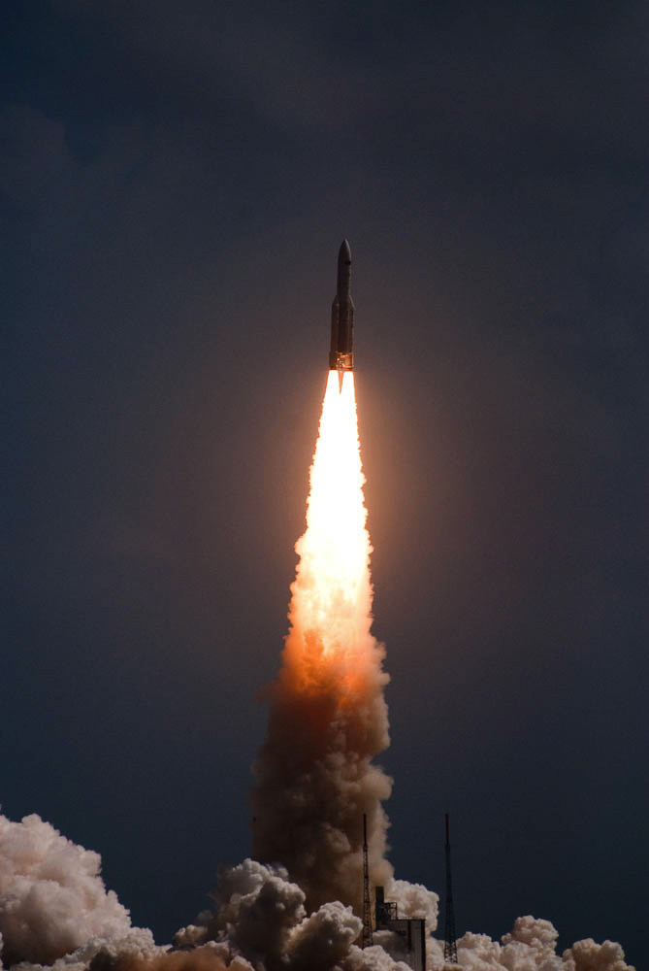
Herschel – The Largest Telescope in Space

Slide 4
PACS and SPIRE Photometers Imaging to 3"
Extragalactic Background Resolved

Slide 5
PACS and SPIRE Photometers Imaging to 3"

Slide 7
Herschel Spectrometers

Slide 8
Herschel Spectrometers
PACS – Gratings

Slide 9
Herschel Spectrometers

Slide 10
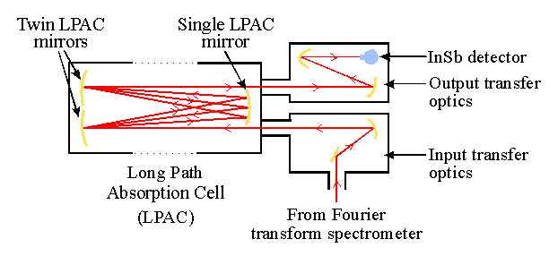
Herschel Spectrometers
SPIRE – Fourier Transform Spectrometer

Slide 11
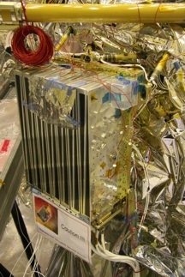
Herschel Spectrometers
HIFI - Heterodyne

Slide 12
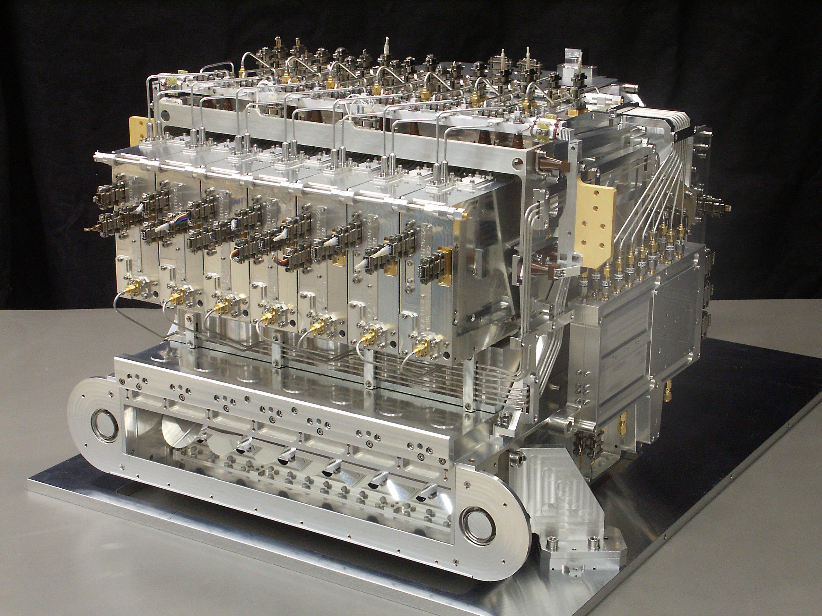
Herschel/HIFI
7 Submillimeter & Far Infrared Mixers Units
0.5 – 1.9 THz
150-600 um
AOS backend
A/C Backend
R~10^7

Slide 13
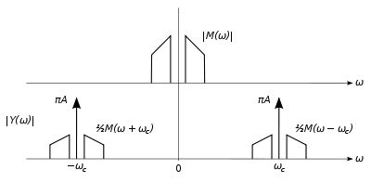
AM Radio – Your local Heterodyne Example
Amplitude modulation is created by forming the product: (same principle as piano tuning!)
cosX cosY = (1/2) [ cos (X - Y) + cos (X + Y) ]

Slide 14
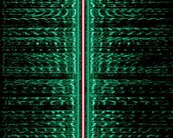
Center, colored red, is the carrier wave at 558 kHz; the two mirrored audio spectra (green) are the lower and upper sideband.
AM Frequency – Time Plot

Slide 15
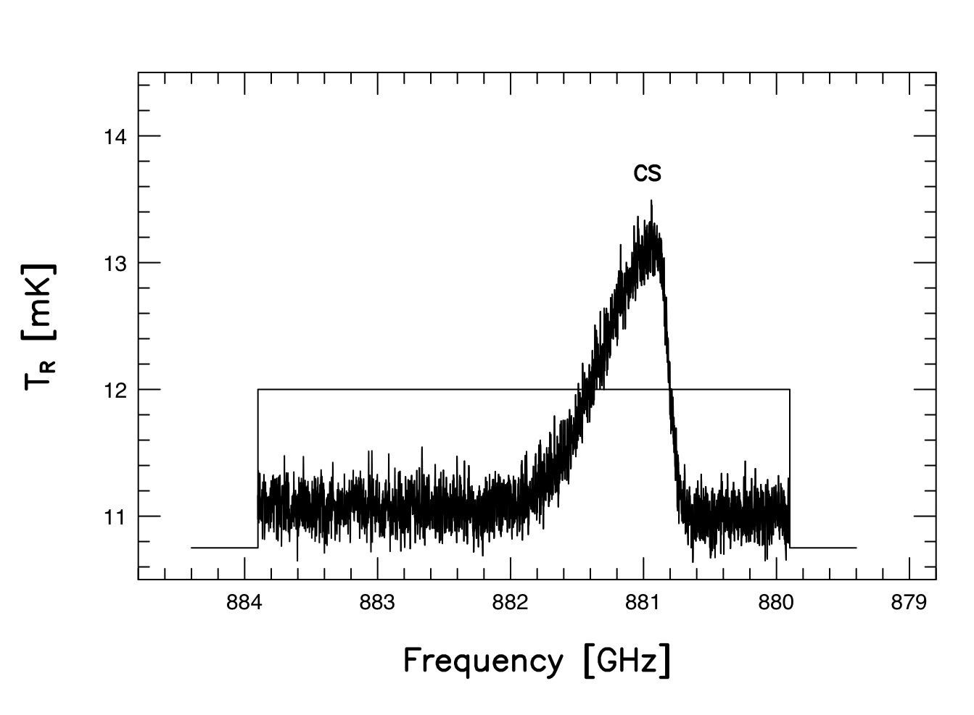
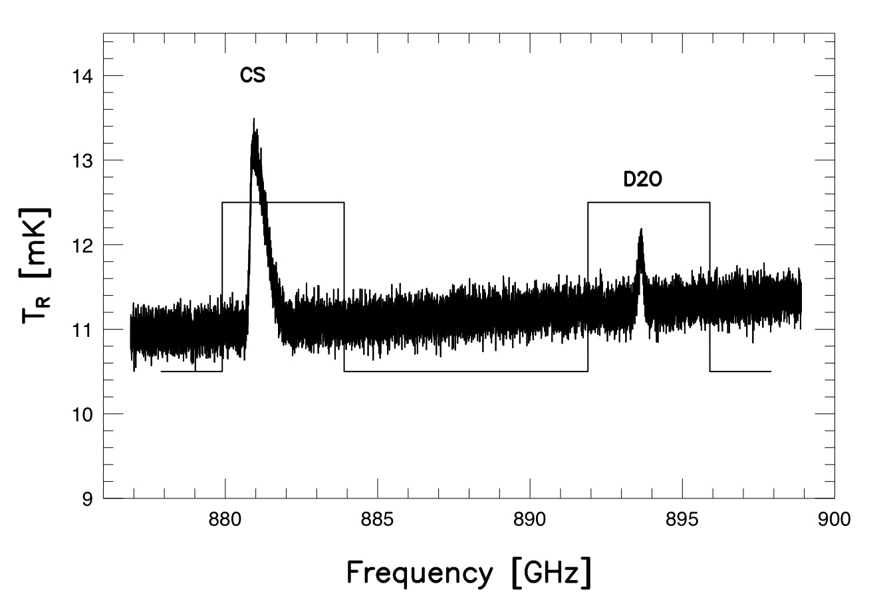
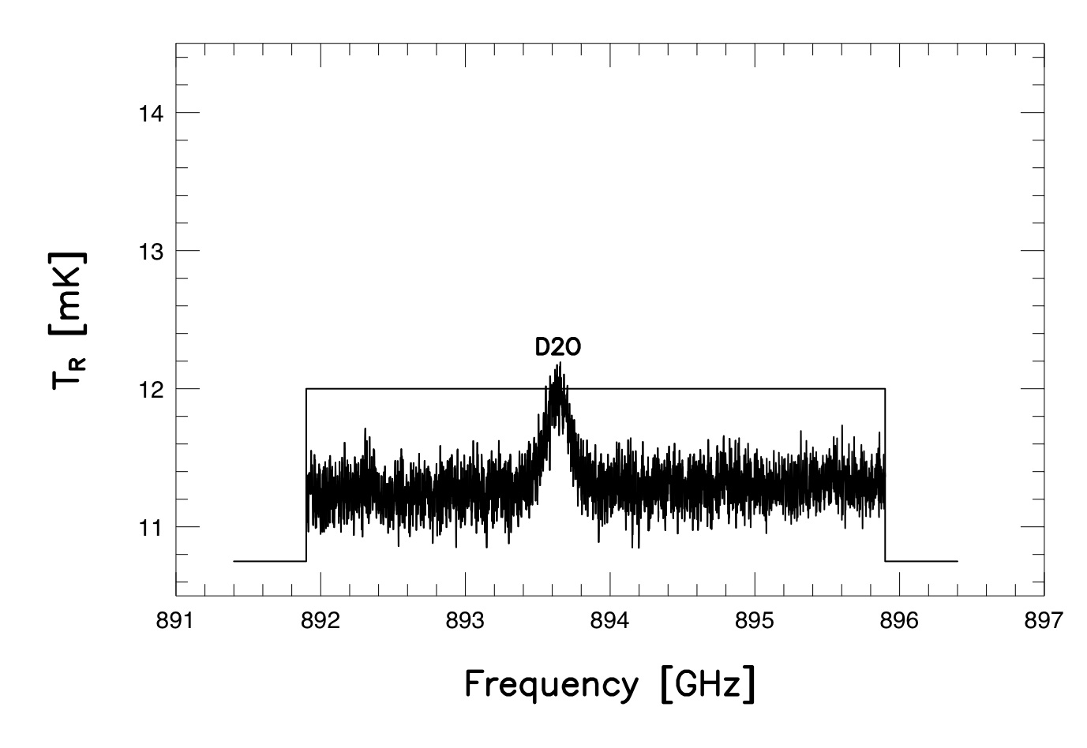
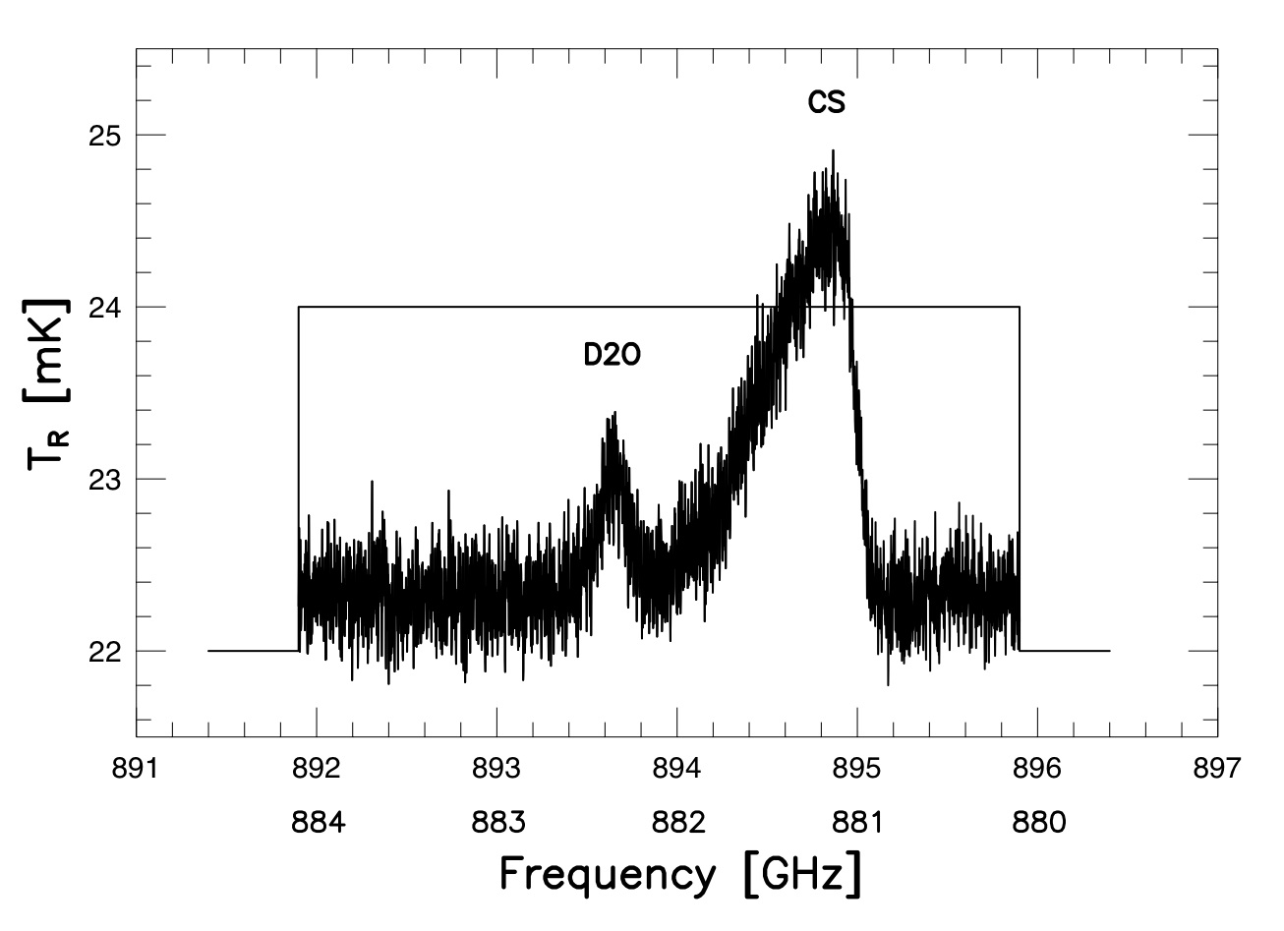
LSB + USB = DSB
LO
Lower sideband spectrum is reversed and added
Two frequency scales result in the DSB result
The lines may blend but they can be recovered (deconvolved)
The continuum levels add (double) in the DSB
The continuum slope is flattened but may be recovered (deconvolved)
The noise adds in quadrature , increasing as sqrt(2)

Slide 16
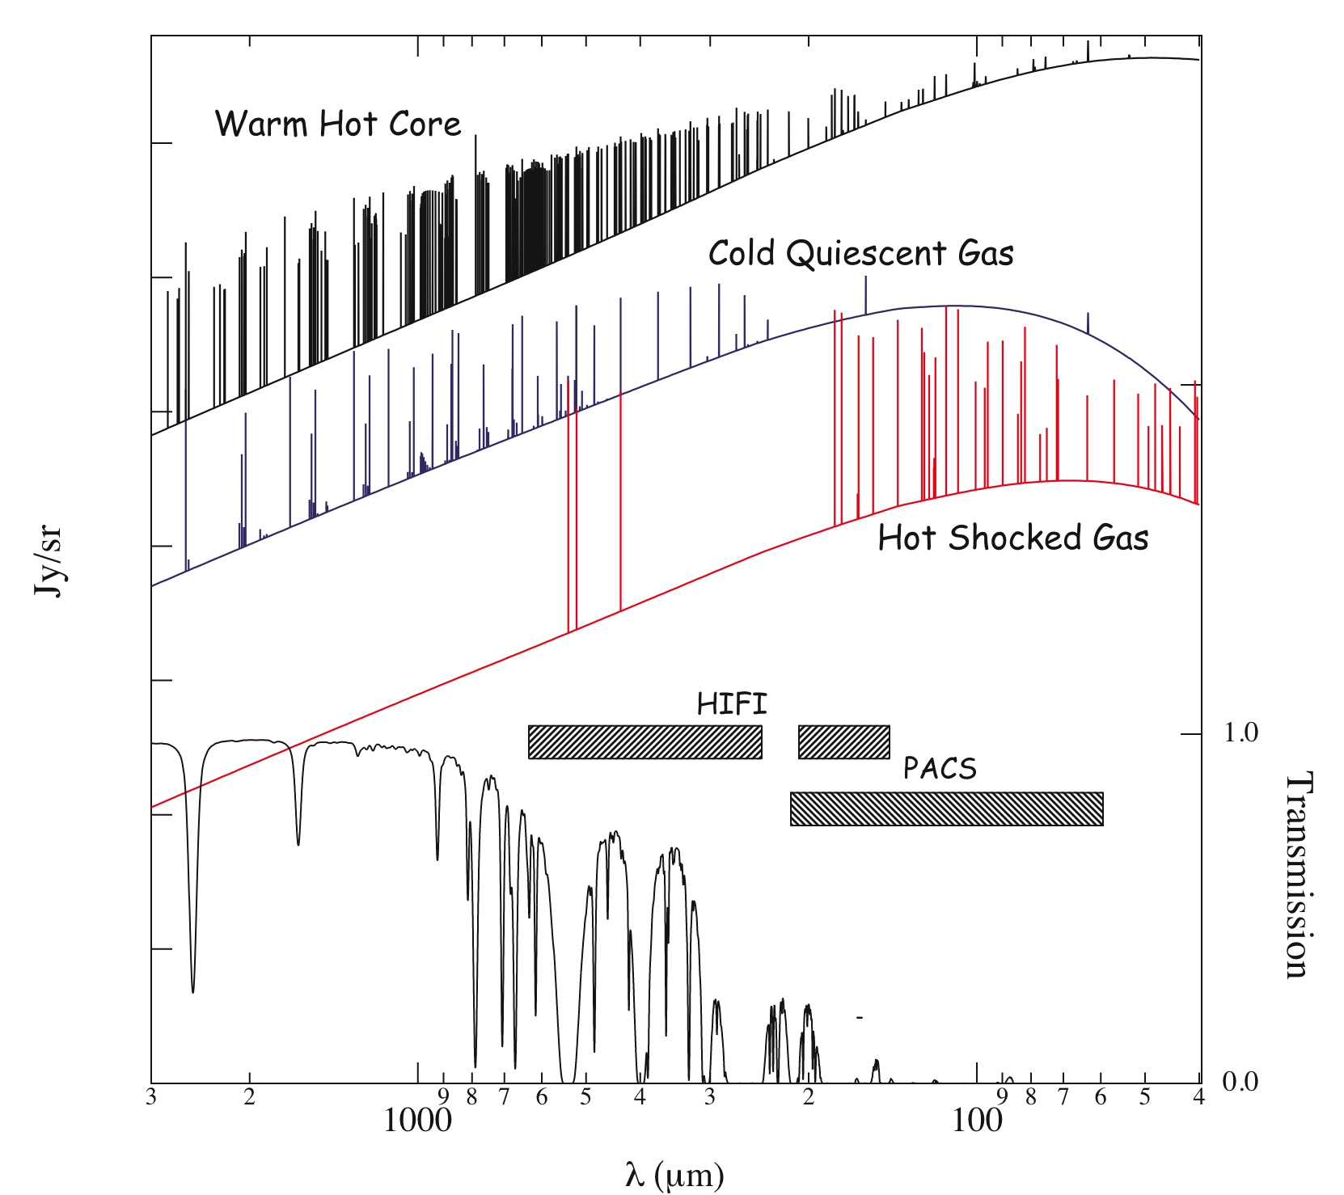
Astrochemistry

Slide 17
Formulation of the Problem
Start with a guess of the answer – a model with no assumptions for the SSB spectrum – flat
"Observe it" – using knowledge of the instrument
compare the observations of the model with the real observations
compute a chi square and a delta (differential) chisquare
each model "spectral channel" was in part ressponsible for some of the chi square change
follow the slope of the chi square downward
always move at right angles – thus Conjugate Gradient Method
Stop when asymptote is reached

Slide 19
Other problems
Bad Standing Waves
Bad Baselines
"Spurs"
Some mitigation possible
Data cleanup
Maximum Entropy added in....

Slide 20
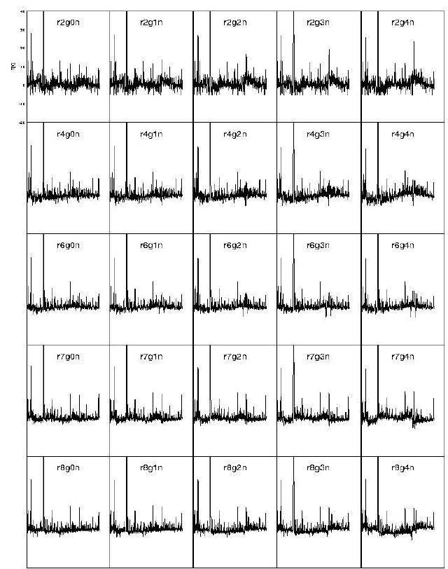
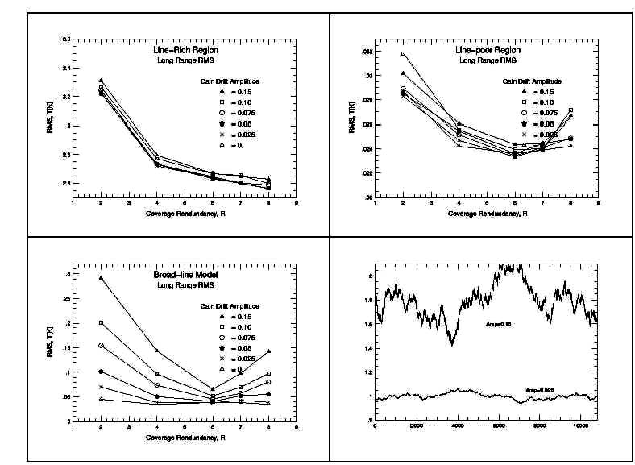
Grain Drift Experiment for Line Rich Source
Gain Drift Amplitude (normalized)
0 1 2 3 4
Deconvolved Spectra
Conclusion:
Higher Redundancy offsets Gain Drift – to a point
Redundancy
8 7 6 4 2
RMS
Redundancy

Slide 21
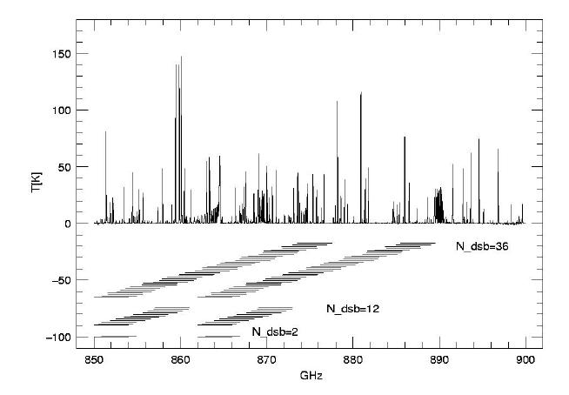
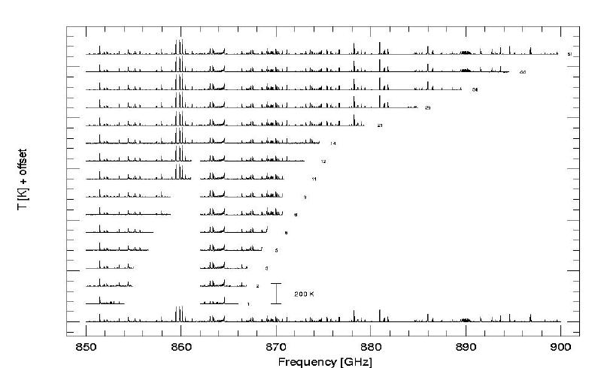
The Smallest Spectral Scan
Completed Deconvolution Study of minimum width survey

Slide 22
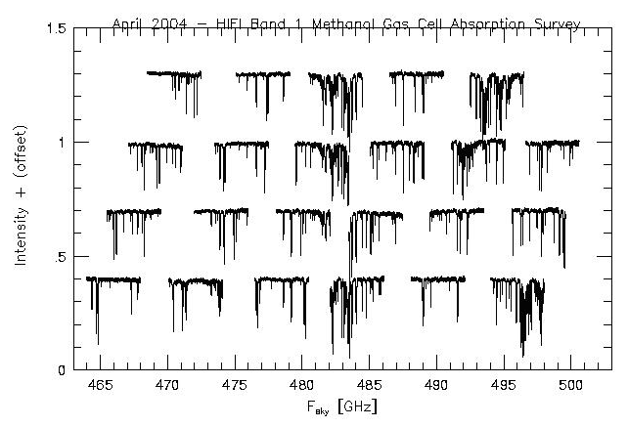
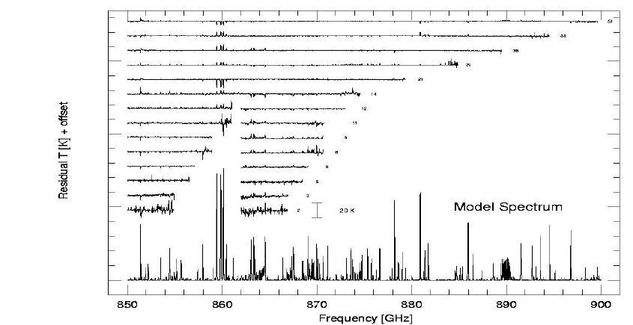
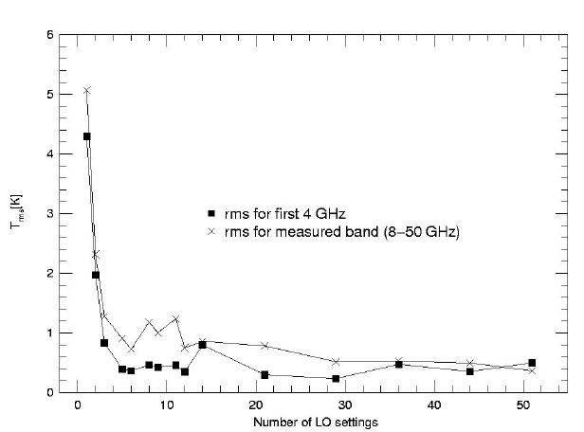
The Smallest Spectral Scan
Completed Deconvolution Study of minimum width survey (con’t)

Slide 23
Deconvolved Methanol Survey

Slide 24
Tool Requirements Outlined
Requirements for JAVA Sideband Separation Tool
Runs via a JAVA Widget or Jython Command Line Script
Can save and reload intermediate steps
Can output intermediate and final steps in various formats
Runs as part of the Data Processing HCSS environment
Allows (as a best effort) automatic processing
Allows User control and intervention (with graphic output of steps)
User can change sequence of what is fit at each iteration (e.g., bias, fringes)
User can blank-out strong known lines for reinsertion later.
Allows Ghost Identification Facilities - i.e. multiple DBS coverages showing where line must appear if it is indeed real
Allows Ghostbusting Capabilities - i.e., shows location where ghost primaries, secondarys, etc. show up on the SSB spectrum
Has labeled and easy to understand multi-colored displays and H/C
Gives product quality information - “goodness of fit” results based on DSB residual and system noise.

Slide 25
JAVA Tool
IPAC Group (, S. Lord, J. Xie, C Borys) Produced The JAVA Tool for IA
Have Conjugate Gradient method running in JAVA
Have done speed test (JAVA vs. FORTRAN) of multidimensional deconvolution – and the speeds are comparable.

Slide 26
A Piece of the User’s GUI

Slide 27
Successful processing – one line

Slide 28
Real Data ...

Slide 29
Success – First Light - Orion Astrochemestry!

Slide 30
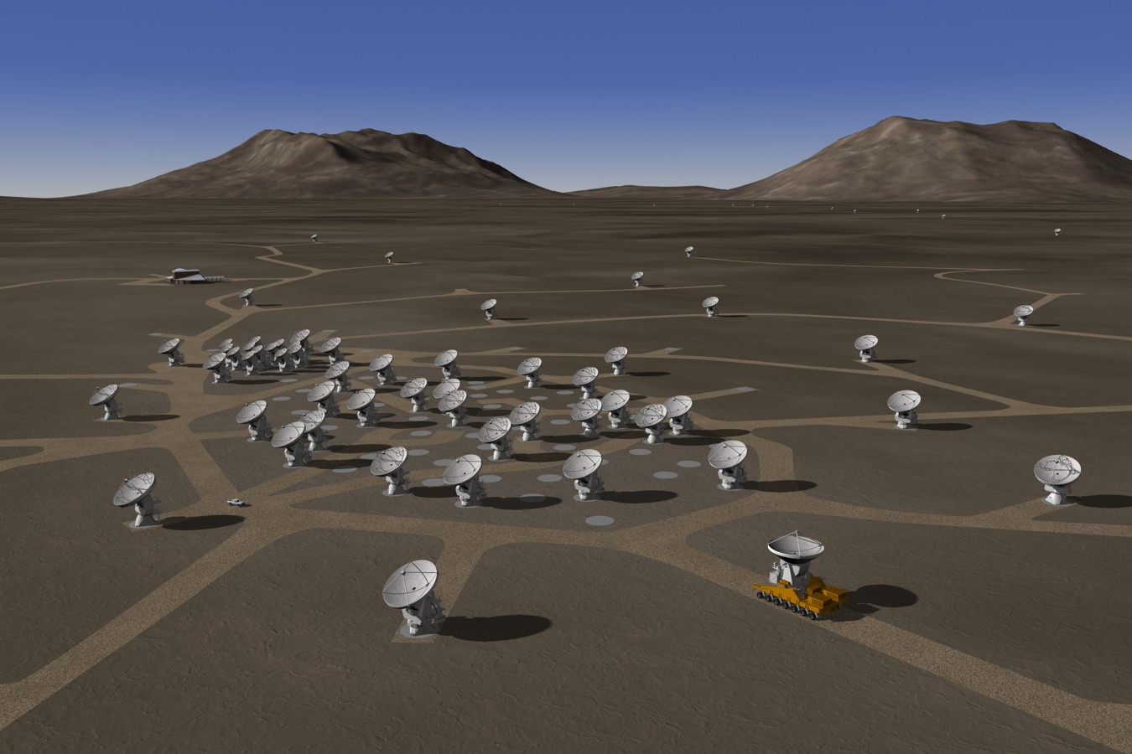
Future Applications – SOFIA? ALMA?

