Slide 1
MOST - Moving Object Search Tool for NEOWISE and IRSA
Kevin Yau
6/11/2010

Slide 2
Introduction
Objectives
Top Level Design
Special Features of Search Method
Current Status and Results
Next Steps and Future Plans
Conclusions

Slide 3
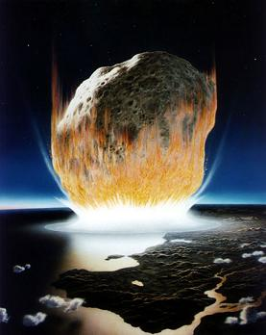
Introduction

Slide 4
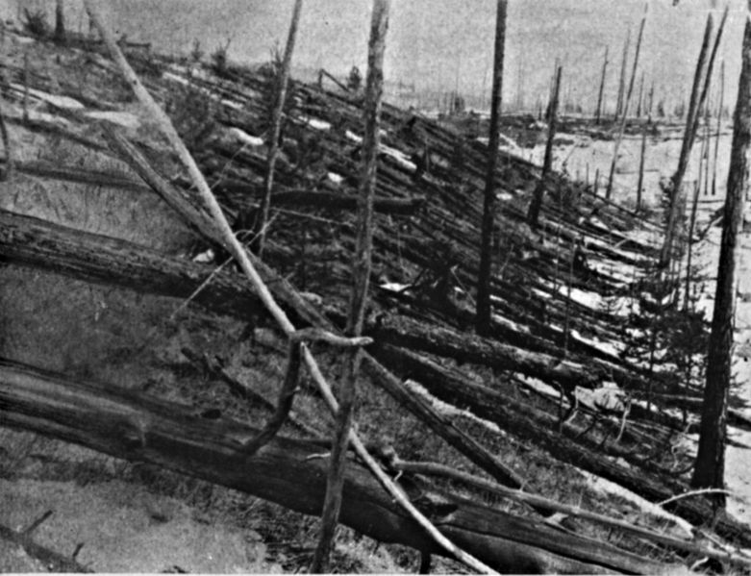
Site of the 1908 Tunguska Event in Siberia, Russia.

Slide 5
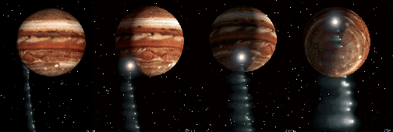
Comet Shoemaker-Levy 9 collision with Jupiter in July 1994.

Slide 6
Objectives
To enable researchers to search for asteroids, comets and any other serendipitous objects in the Solar System in the infrared astronomical catalogs of WISE and other IRSA archives such as Spitzer and PTF (Palomar Transient Factory).

Slide 7
Top Level Design

Slide 8
Special Features of Search Method
Narrow down the millions of images using a combined spatial and temporal search method.
Use search boxes to constraint search to certain regions of sky – by only selecting images along orbital track.
Use the image frame time tag to further refine the searches - by directly calculating the object position using frame time instead of a curve fit.
Advantages over other algorithms: For example, SkyMorph used by NEAT searches every image frame.

Slide 9
Spatial Constraint Technique Using RA and Dec Search Boxes

Slide 10
Current Status and Results

Slide 14
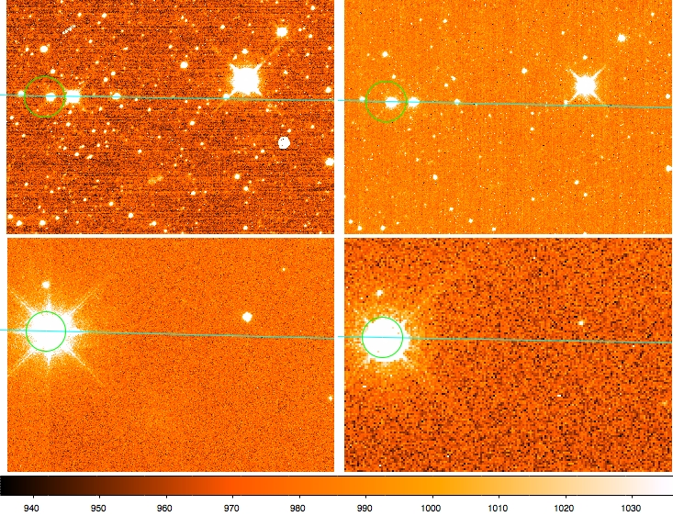
w1
w2
w3
w4
A Sample of Identified Image Frames containing Asteroid Victoria for the four WISE bands w1, w2, w3 and w4 respectively at 3.4, 4.6, 12 and 22 μm.

Slide 15
Next Steps
Improve accuracy of results by revising the computation steps.
Improve efficiency of search by automatically adjusting the size of search boxes based on the motion of the object.
Integrate the standalone tool into the WISE image archive service.

Slide 16
Future Plans
Extend the search tool to include multiple image sets from other IRSA archives.
An observer module to handle different spacecraft parameters.
Ability to find nearby images, useful in refining orbit.
Draw vectors to indicate comet tail direction.

Slide 17
Conclusions
Will provide a tool that will help researchers to locate image frames containing asteroids and comets in the WISE archive and also other IRSA catalogs.
Which will help researchers study and understand their physical parameters and long-term orbital evolution especially those Near Earth Objects.
Hopefully will prevent us from following the path of dinosaurs.
ACKNOWLEDGMENTS: I would like to thank Steve Groom for providing helpful comments on the draft of this presentation and Roc Cutri for getting approval for showing the WISE images.

Slide 18
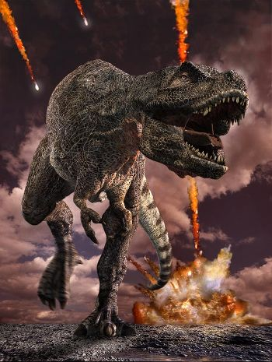
HELP!

