Slide 1
WMOPS -
Clean Detections of Newly Discovered Solar System Objects by WISE
J. Dailey, J. Bauer, T. Grav, A. Mainzer, R. Cutri, J. Myers, J. Masiero, R. McMillan, S. Gomillion, R. Jedicke, L. Denneau, R. Walker, E. L. Wright, and the WISE Team

Slide 2
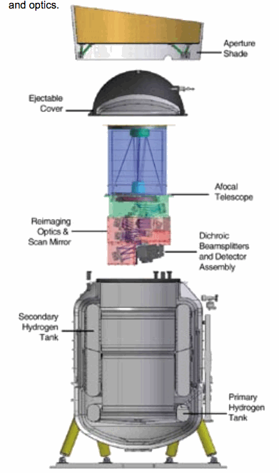
WISE Spacecraft
Successful launch on Dec 17, 2009
HgCdTe + Cryogenically cooled Si-As detectors
4 Bands at 3.4, 4.6, 12 and 22 μm
Polar orbit: completes a full orbit (2 scans) every 92min., progresses 2 deg in ecliptic longitude/day
Coverage of at lease 8 frames at the equator, denser coverage at the poles, ~10 frames per region of sky on average
CAVEAT… scans don’t progress linearly, they do a 4-pattern jump and have additional offsets to avoid the Moon.

Slide 3
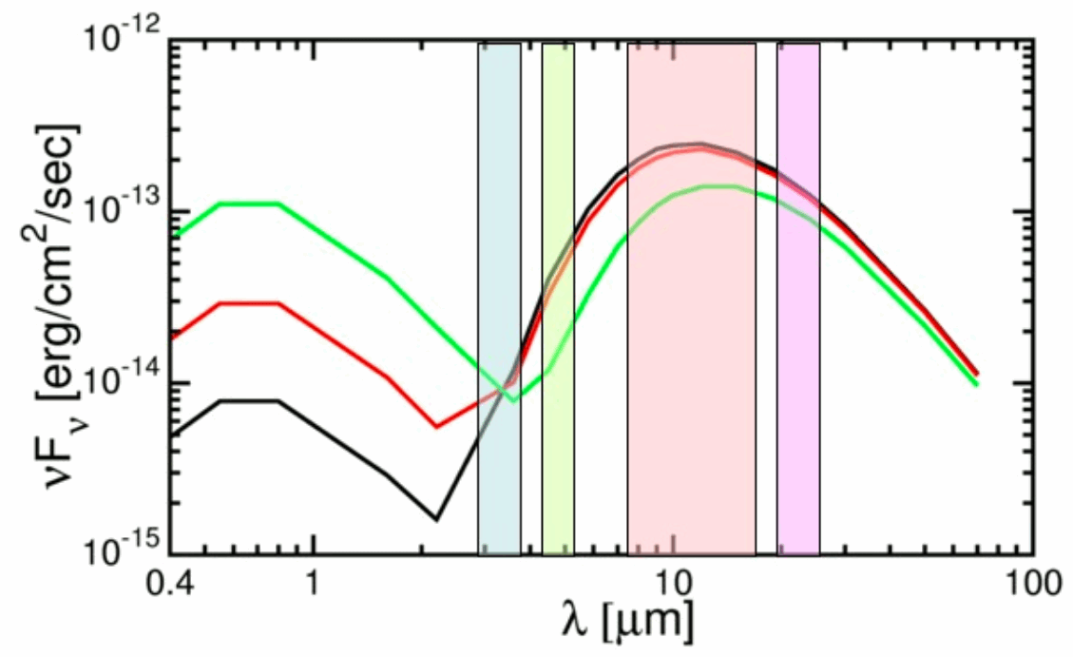
WISE & NEOs
Detection & Characterization of Near Earth Objects primary motivation
Bands optimized for detection of Inner solar system objects
Can obtain Size Estimates from IR fluxes alone
Similar Visual Brightness
2.3% albedo, 2.6 km diameter
63% albedo, 0.5 km diameter
Similar IR Brightness
2.3% albedo, 2.6 km diameter
63% albedo, 1.6 km diameter

Slide 4
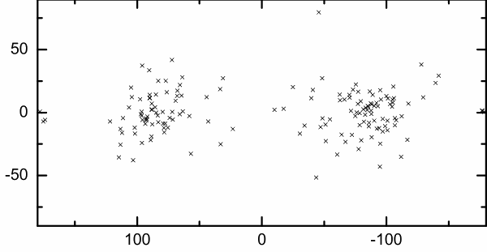
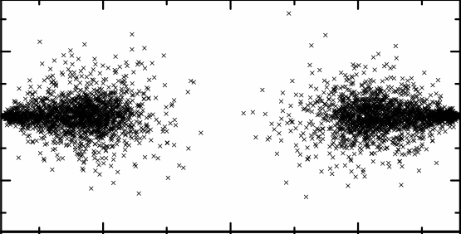
WISE & Other Survey search geometries & PHAs
Opposition
WISE scans
Veres et al. 2009.
Opposition-centered ecliptic coordinates for V=22.7, H=20 (~300m) objects (simulated earth-impactors, 20yr prior to impact).
Current Count: 66 NEAs, giving WISE the 2nd highest discovery rate of NEOs for all the active surveys.

Slide 5
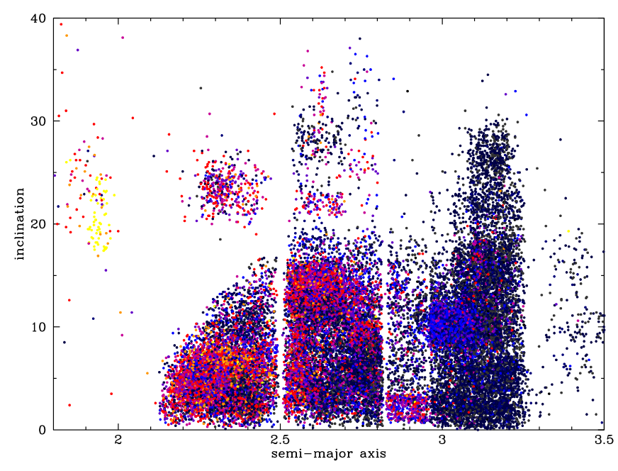
MBAs
Many of the MBAs have measured optical brightness – yields albedos
Albedos can be correlated with Asteroid families
EUNOMIA
VESTA
EOS
FLORA
THEMIS
Courtesy J. Massiero

Slide 6
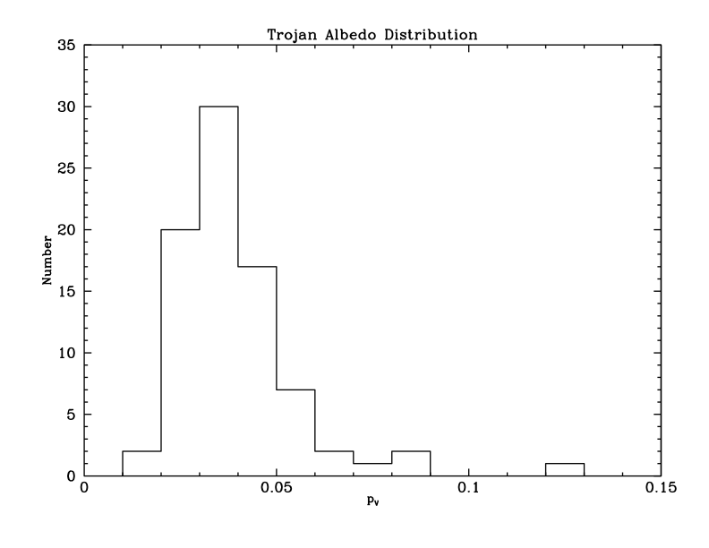
Jupiter Trojans
Able to study the populations of the 2 Trojan asteroid clouds at L4 and L5
Differences in number density and albedo
Courtesy T. Grav

Slide 7
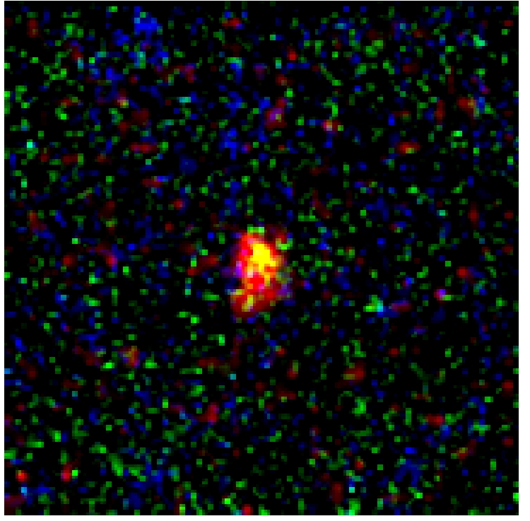
Comet WISE Discoveries I
Bands 2-4 three color images
WISE is an excellent means of detecting cometary dust
P/2010 B2 (WISE)
P/2010 D1 (WISE)
C/2010 D2 (WISE)
C/2010 DG56 (WISE)
C/2010 D3 (WISE)
C/2010 D4 (WISE)
C/2010 E3 (WISE)
C/2010 G3 (WISE)

Slide 8
WISE Discoveries of Cometary Activity -II
Bands 2-4 three color images
C/2010 J4 WISE
C/2010 K2 WISE
C/2010 FB87(Garradd-WISE)
233P/La Sagra (2009 WJ50)
P/2010 L1 WISE
P/2009 WX51 (Catalina)

Slide 9
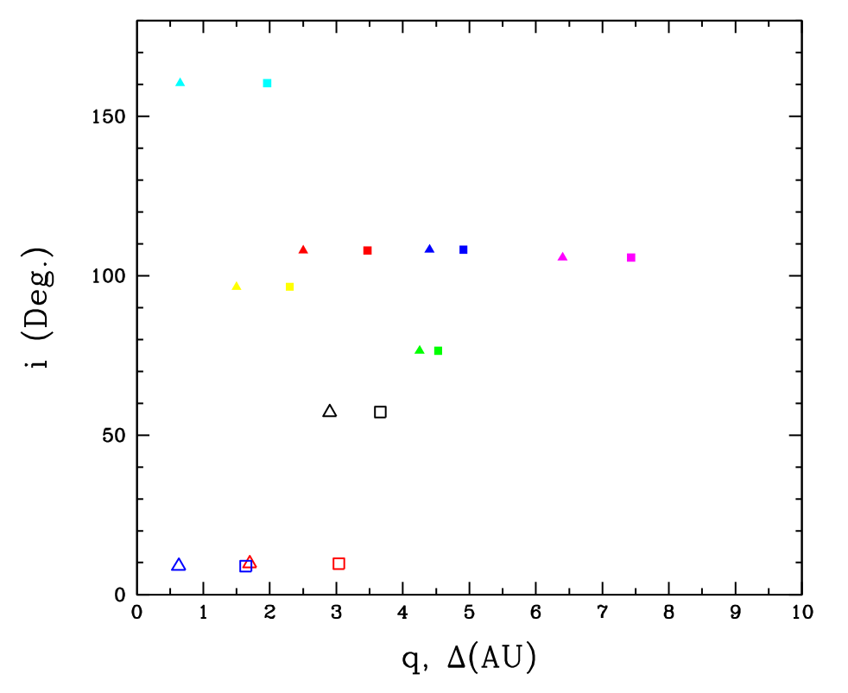
WISE Comets: Distance & Inclination
Most WISE comets are on higher-inclination orbits.
~1/4th have perihelia beyond 4AU.
~1/2 are long-period comets, 4 with nearly-parabolic orbits.
C/2010 J4
C/2010 DG56
C/2010 FB87
C/2010 G3
C/2010 D4
C/2010 E3
C/2010 D3
− Perihelion
− Helio. distance at Discovery
P/2010 D2
P/2010 L1
P/2010 B2
P/2010 D1
P/2010 K2
R

Slide 10
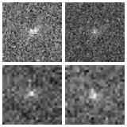
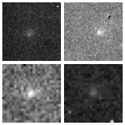
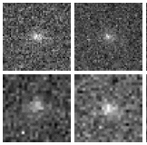
Known Comets
Observed in varying degrees of activity
Inactive yields unambiguous nucleus size
Active yields particle size distribution & dust mass estimates
14 newly discovered comets + 68 known ≈ 82 comets observed total
12 μm
22 μm
47P/Ashbrook-Jackson
127P/Holt-Olmstead
12 μm
22 μm
67P/Churyumov-Gerasimenko
14P/Wolf
P/Gibbs 10 (2009 S1)

Slide 11
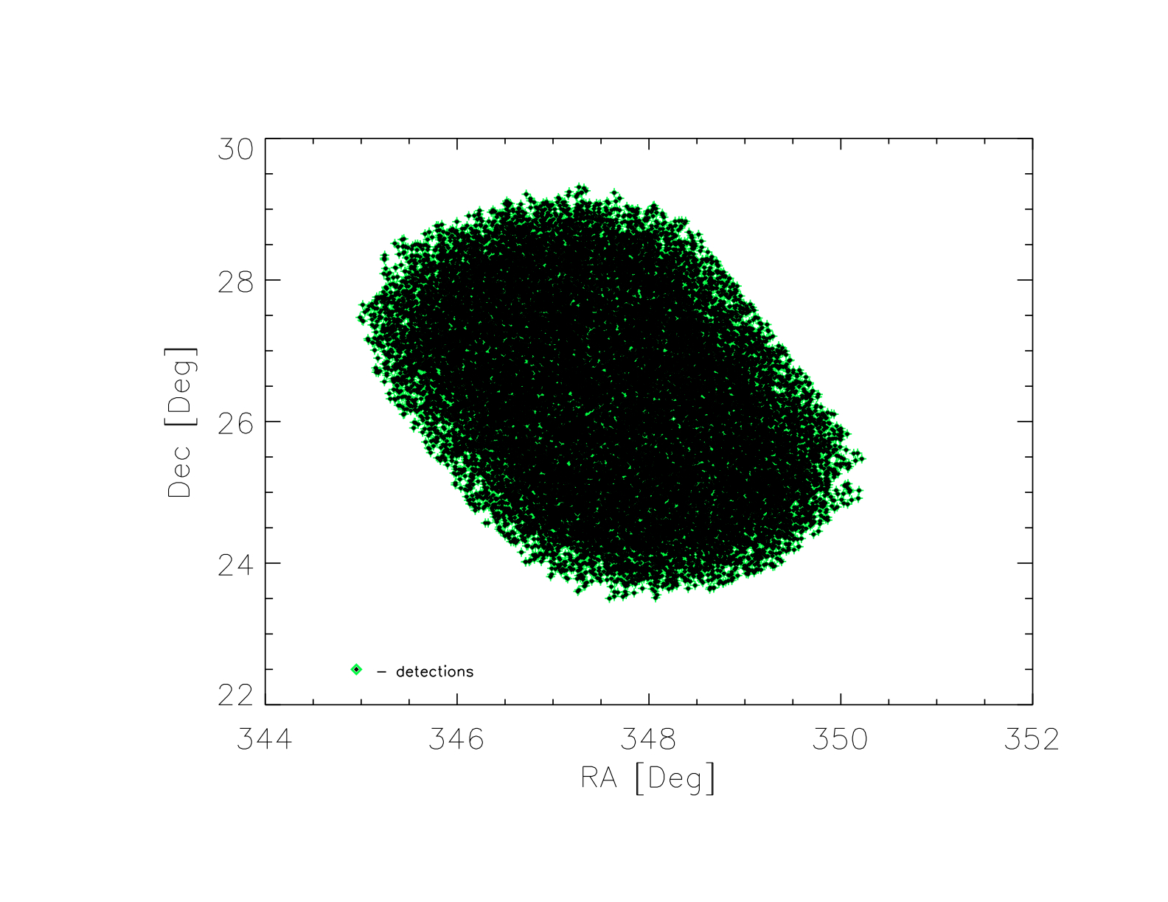
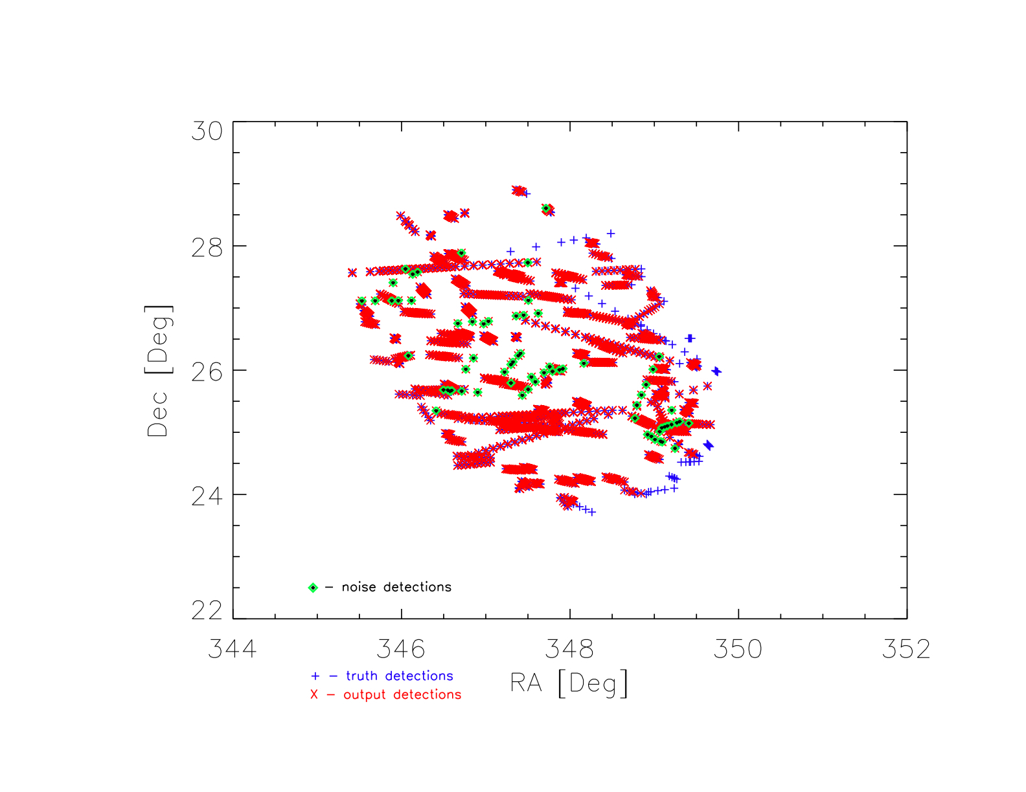
What WMOPS does
Simulated truth detections mixed with 100 points of randomly added noise sources per frame.
detections extracted by WMOPS.
WMOPS successfully identified 92% of the objects and 97% of objects reported by WMOPS were accurate (detections of only one object, with no noise points present).
Notes:
2 degree by 2 degree simulated patch,
performance is worst on the perimeter
On larger patches completeness is substantially better.

Slide 12
How WMOPS does it
Level 1b
mdex tables & fits images
Moving Object Pipeline
External pipeline input
Check for Overlap Frames
External pipeline product
Stationary Object Rejection & S/N & Artifact rejection
Frame Database
Internal pipeline product for eyes-on evaluation
Findtracklets: create new detection pairs from unreduced frames
Frame state, location, and time.
Multiple iterations of Collapsetracklets on Overlap Frame regions
Tracklet Database
Detection time and location &
Tracklet associations
Garbage collection
SSOID input
Format Conversion
QA - evaluation
SSOID match & QA filtering
Archive (Tracks & object-level QA products)
Known solar system object identification
Archive Preparation
QA loop
Submit to MPC

Slide 13
Findtracklets
Level 1b
mdex tables & fits images
Moving Object Pipeline
External pipeline input
Check for Overlap Frames
External pipeline product
Stationary Object Rejection & S/N & Artifact rejection
Frame Database
Internal pipeline product for eyes-on evaluation
Findtracklets: create new detection pairs from unreduced frames
Frame state, location, and time.
Multiple iterations of Collapsetracklets on Overlap Frame regions
Tracklet Database
Detection time and location &
Tracklet associations
Garbage collection
SSOID input
Format Conversion
QA - evaluation
SSOID match & QA filtering
Archive (Tracks & object-level QA products)
Known solar system object identification
Archive Preparation
QA loop
Submit to MPC

Slide 14
Findtracklets – the starting point for tracklets
Makes all pairs that are possibly the same object based solely on sky plane speed.
Ignores all magnitude (and other possible) information.
T2
Speed Limit Boundary
T2
T1
Findtracklets
T1
T2
T2
T2
T2
T2
T2
Tracklets
T2

Slide 15
Collapsetracklets
Level 1b
mdex tables & fits images
Moving Object Pipeline
External pipeline input
Check for Overlap Frames
External pipeline product
Stationary Object Rejection & S/N & Artifact rejection
Frame Database
Internal pipeline product for eyes-on evaluation
Findtracklets: create new detection pairs from unreduced frames
Frame state, location, and time.
Multiple iterations of Collapsetracklets on Overlap Frame regions
Tracklet Database
Detection time and location &
Tracklet associations
Garbage collection
SSOID input
Format Conversion
QA - evaluation
SSOID match & QA filtering
Archive (Tracks & object-level QA products)
Known solar system object identification
Archive Preparation
QA loop
Submit to MPC

Slide 16
Collapsetracklets – the heart of WMOPS
Extrapolate positions and velocities for all tracklets to the average time in the input set
If at the average time the positions and sky plane velocities of two tracklets match, collapse the two tracklets to one tracklet.
T1
T1
Collapsetracklets
T2
T2
One tracklet
Collapsetracklets
Te
T3
Two tracklets
T3
Collapsetracklets
T4
T4

Slide 17
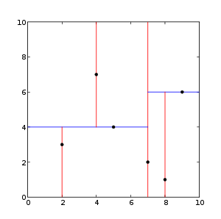
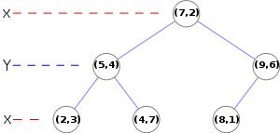
KDTrees – the magic behinds Collapsetracklets
Naïve position and velocity matching would be prohibitively expensive - O(n^2)
Partition data at the median in each dimension
Cycle through dimensions
Each comparison reduces the number of candidates by 50% - O(n*log(n))
(2,3), (5,4), (9,6), (4,7), (8,1), (7,2)

Slide 18
Findtracklets
Level 1b
mdex tables & fits images
Moving Object Pipeline
External pipeline input
Check for Overlap Frames
External pipeline product
Stationary Object Rejection & S/N & Artifact rejection
Frame Database
Internal pipeline product for eyes-on evaluation
Findtracklets: create new detection pairs from unreduced frames
Frame state, location, and time.
Multiple iterations of Collapsetracklets on Overlap Frame regions
Tracklet Database
Detection time and location &
Tracklet associations
Garbage collection
SSOID input
Format Conversion
QA - evaluation
SSOID match & QA filtering
Archive (Tracks & object-level QA products)
Known solar system object identification
Archive Preparation
QA loop
Submit to MPC

Slide 19
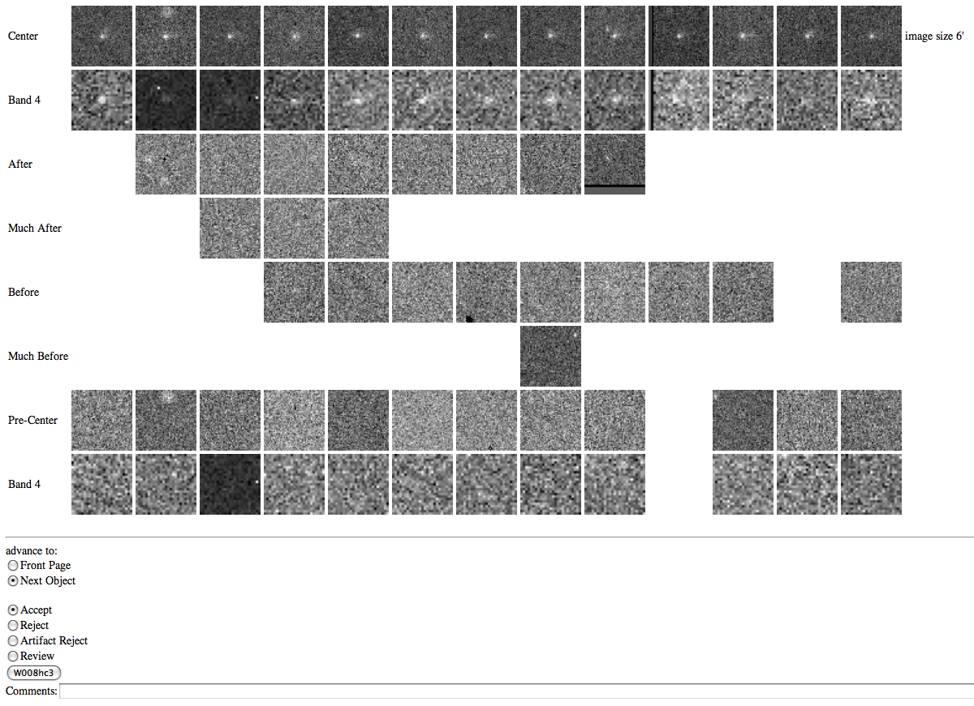
WMOPS Quality Assurance
Notes:
Discovery of cometary activity in P/2009 WJ50 (La Sagra) initially in the WMOPs QA page raw image arrays

Slide 20
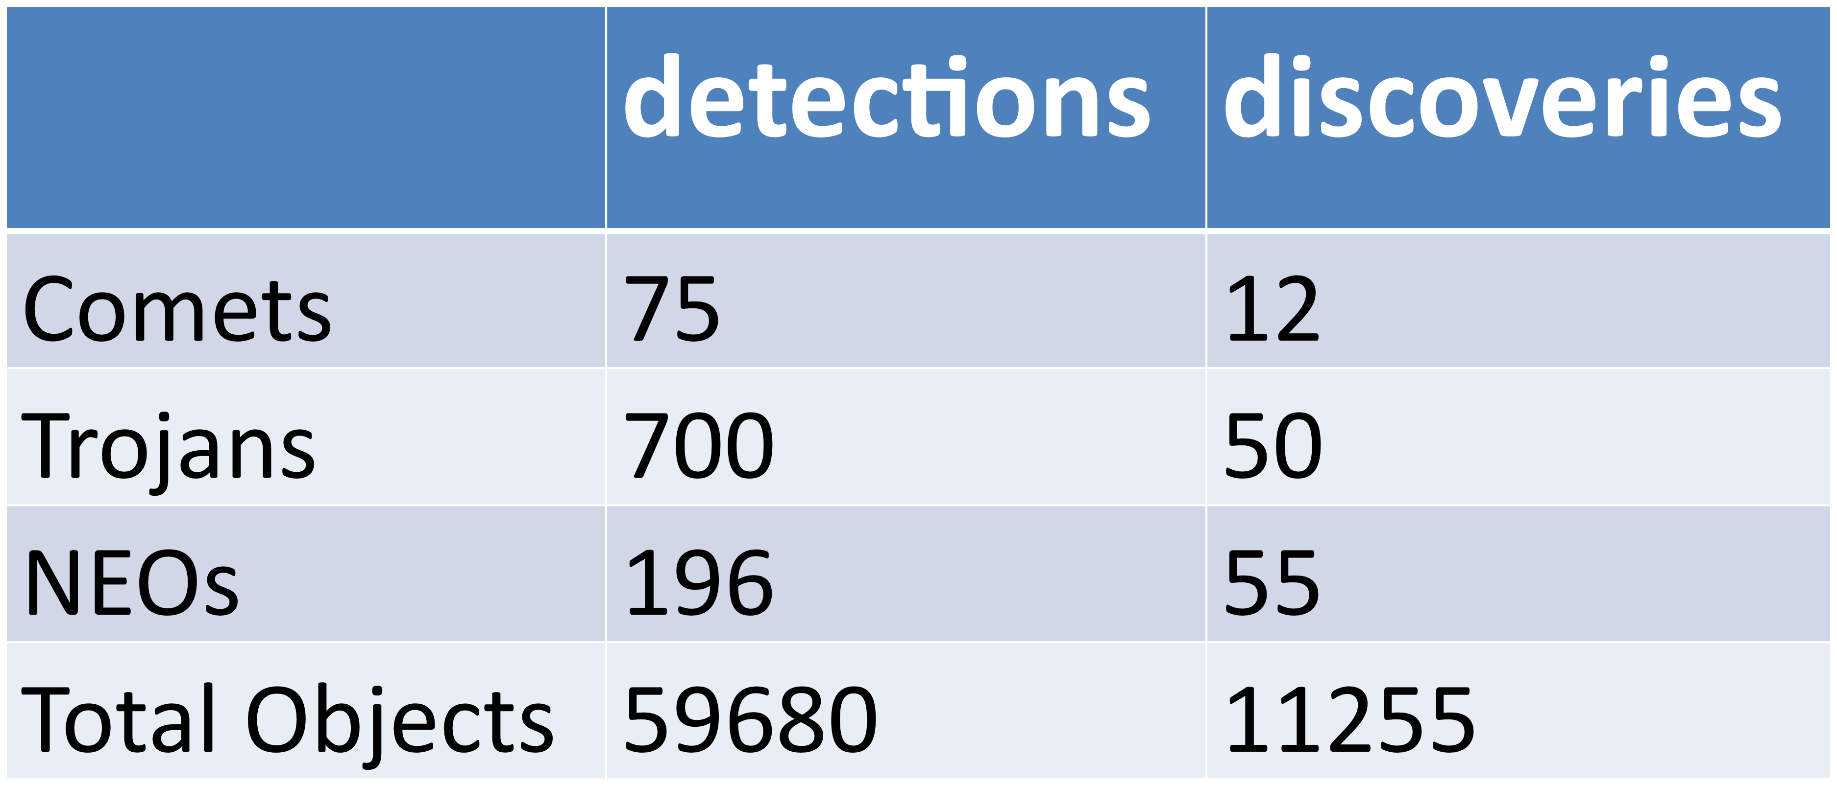
Any Questions?
WMOPS Statistics
(1/14/10-6/07/10)
82
14
1159
203
240
66
80,143
15,076

