Slide 1
The NASA/NExScI/IPAC
Star and Exoplanet Database
David R. Ciardi
on behalf of the NStED Team
14 May 2009
Notes:
4

Slide 2
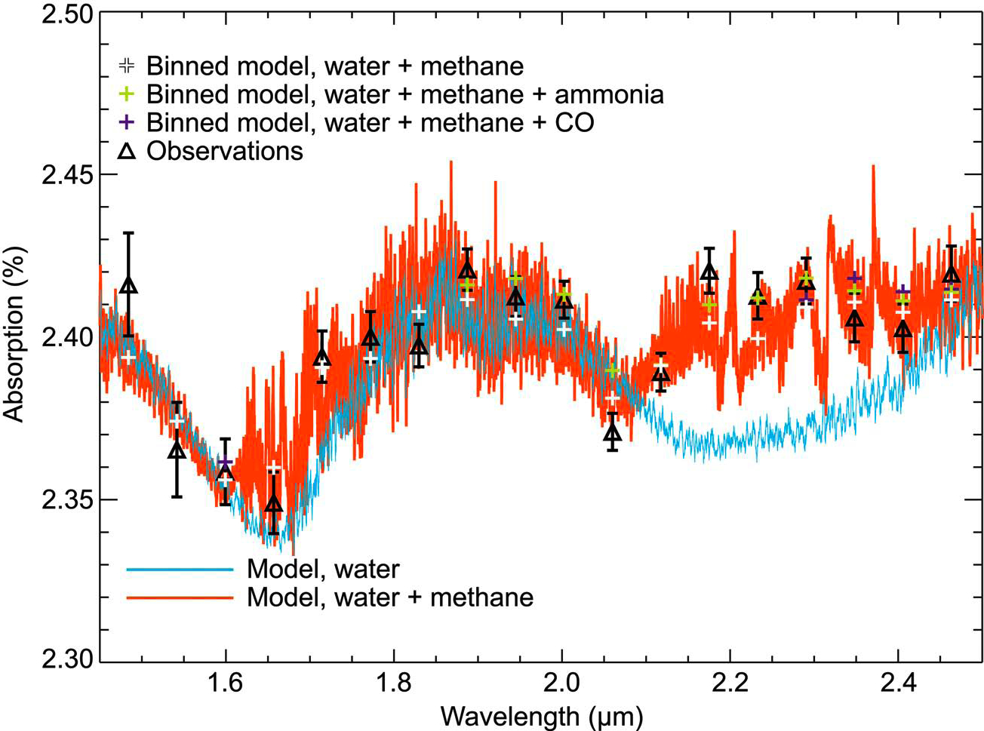
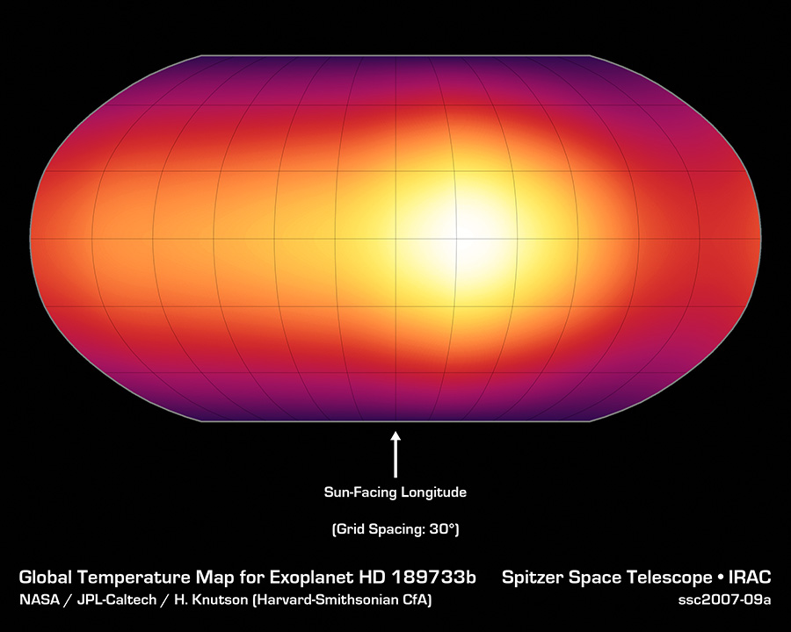
Exoplanet astrophysics is upon us …
NASA Exoplanet Science Institute (NExScI)
Support NASA’s exoplanet characterization and discovery activities
Enormously dynamic field changing on weekly timescale
NExScI archives (in particular NStED) is response to a need for an archive dedicated to NASA’s Astrophysics Exoplanet Exploration activities
Spitzer 8mm map of HD 189733 showing hotspot (Knutson et al 2008)
HST spectrum of HD 189733 showing methane at 2.2 mm (Swain et al 2008)

Slide 3
NExScI Archive
Four major datasets in NExScI Archive
NStED: NASA Star and Exoplanet Database
KOA: Keck Observatory Archive
KI: Keck Interferometry Archive
PTI: Palomar Testbed Interferometer Archive
Focus in this talk on NStED
NExScI archive takes full advantage of the infrastructure and expertise of two mature archives at IPAC: IRSA and NED

Slide 4
How NExScI Benefits from IRSA and NED
NExScI Archive expertise built on legacy of IPAC’s data center operations
IRSA
IRSA architecture and infrastructure is highly re-usable by design
NStED inherits from IRSA
Science information system for processing user queries
Mass-storage and server architecture
Configuration Management System and Code Repository
Testing Methodology
User Support Tools
NExScI and IRSA share purchase and licensing costs where appropriate
NED
NStED is a close stellar analog of NED
Relational database design was used in the development of NStED
Name resolver software was adapted
Catalog and cross-identification expertise used to provide object name cross-ids
Reference coding was used for tracking the literature (also used by ADS)

Slide 5
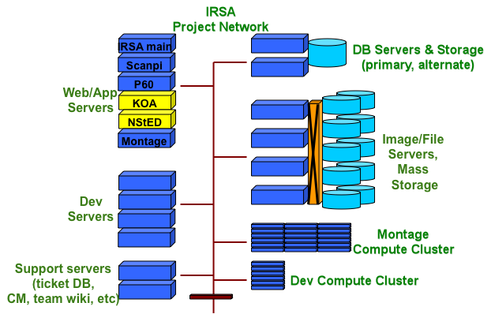
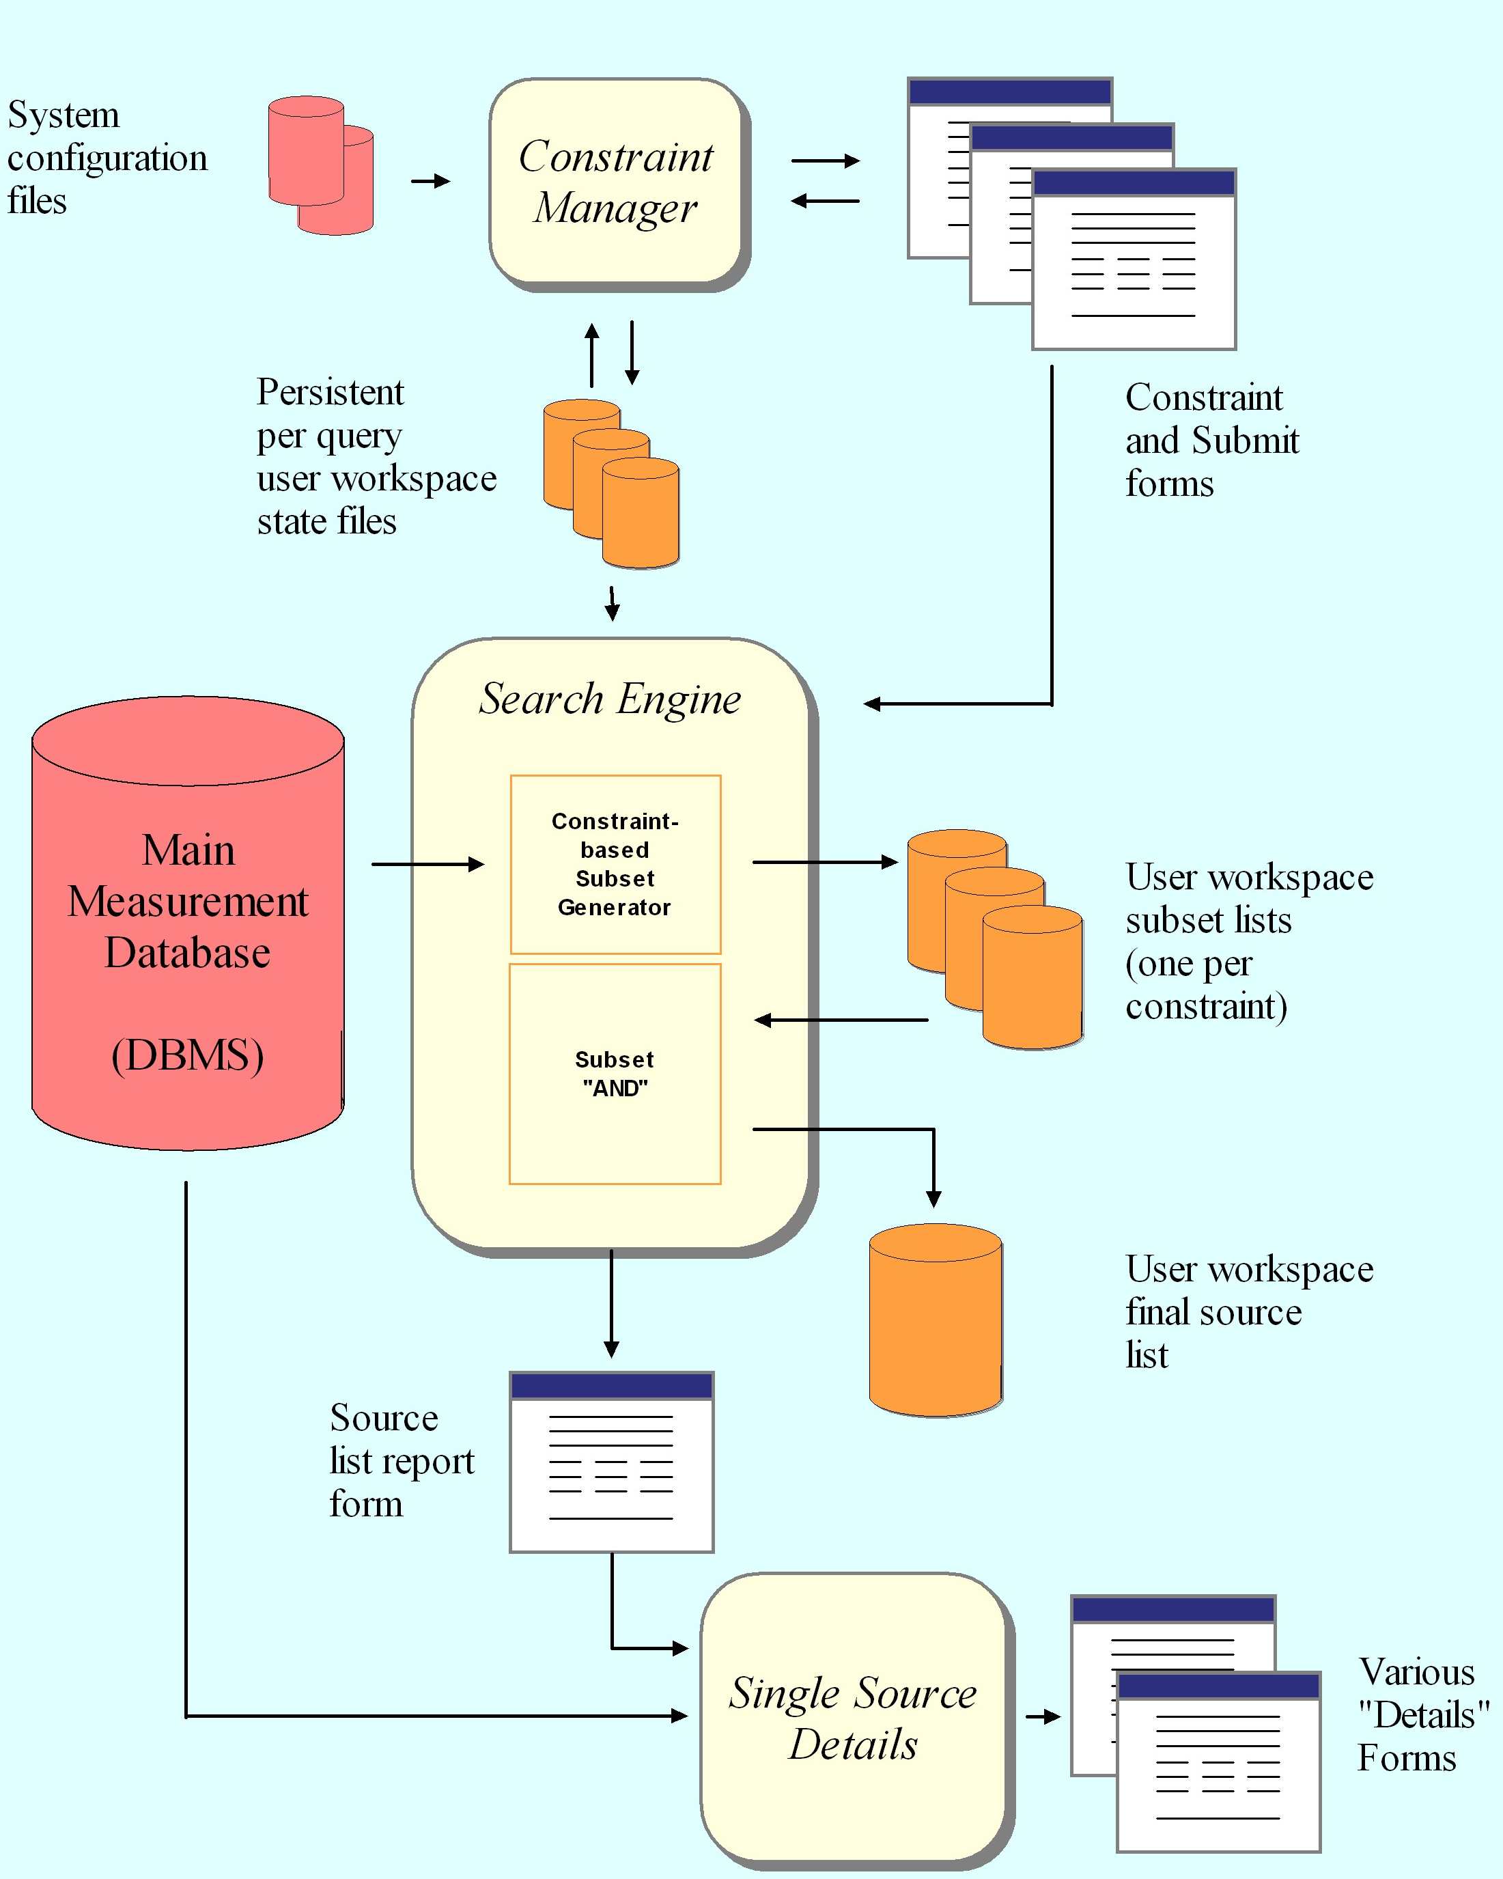
A Common Architecture with IRSA
IRSA uses a component based architecture which enables strong re-use and adaptation
Unrestricted by wavelength and type of mission
Highly extensible and reusable component-based architecture:
Each component is a module with a standard interface that communicates with other components and fulfills one general function
Components plugged together to make user services
Optimized for astronomical spatial searches and complex, general queries
Extended to support NStED
Complex proprietary data protection
Interfaces and return built dynamically from configuration files (150 to date)

Slide 6
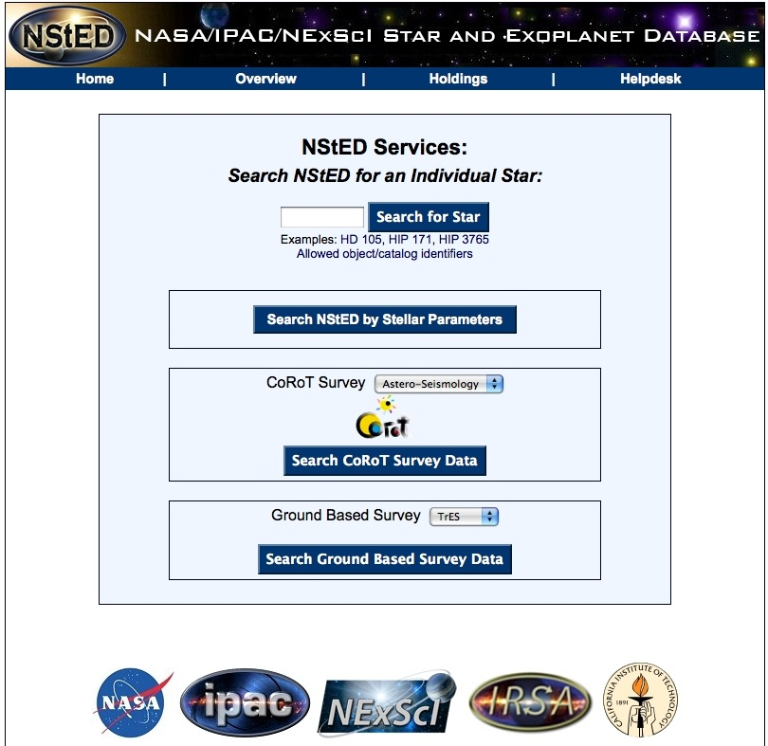
NASA Star and Exoplanet Database (NStED)
Database of nearby stars and exoplanets
Stellar Services
Data related to relatively bright nearby stars
All known planet-hosting stars
Query for individual stars or by stellar/planetary parameters
Images and spectra
Exoplanet Services
Data related to known exoplanets
Time series data of exoplanets
Radial velocity and photometric light curves
Dedicated interface for exoplanet transit surveys
Enables complex and detailed searches on potential and known exoplanet stellar hosts
Pages built dynamically to accommodate changes and additions easily without rewriting core software
Relatively new service: opened July 2007
Major Interface and content update May 2008
Use of NStED continues to grow

Slide 7
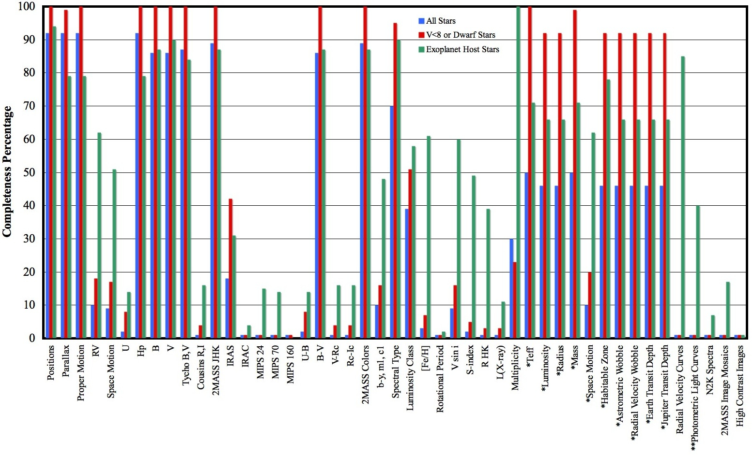
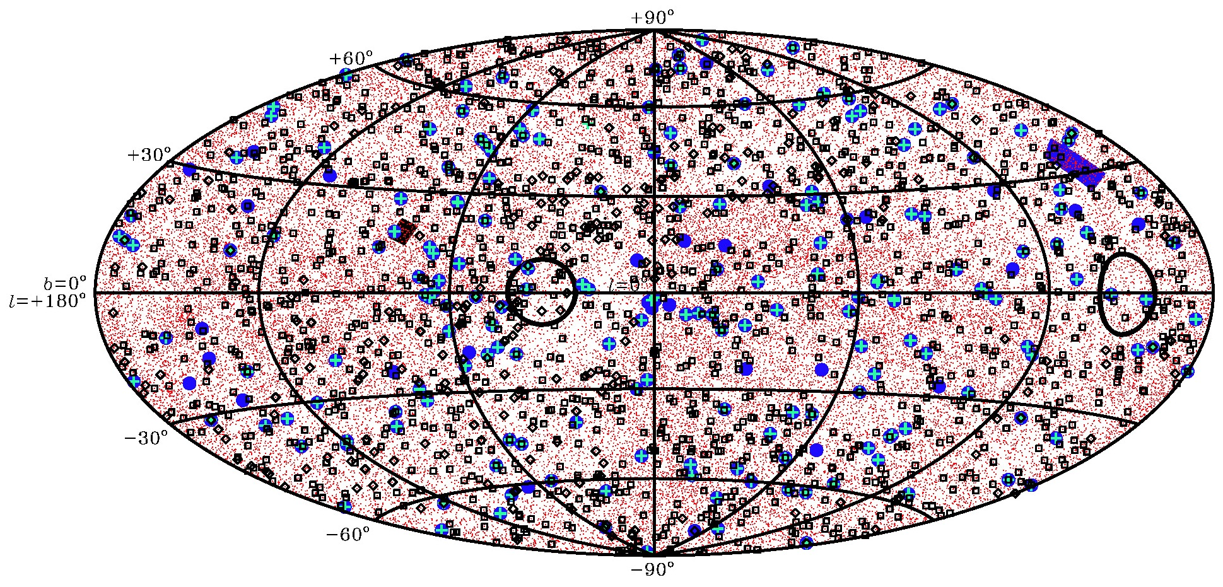
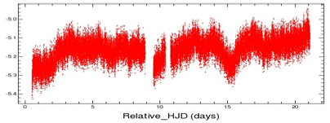
NASA Star and Exoplanet Database (NStED)
Stellar Content for ~140,000 stars
Exoplanets content for all known systems
300,000 light curves from transit surveys
Published Parameters | Derived Parameters | Associated Data
Position, Distances Kinematics Photometry, Colors Spectral type Luminosity Class Metallicity Rotation Activity Indicators Variability Multiplicity Number of Planets Planetary Mass Orbital Parameters | Temperature Luminosity Radius Mass LSR Space Motion Habitable Zone Sizes Astrometric and Radial Velocity Wobbles | Images Spectra Radial velocity curves Lightcurves of transiting exoplanetary systems Jupiter and Earth sized transit depths

Slide 8
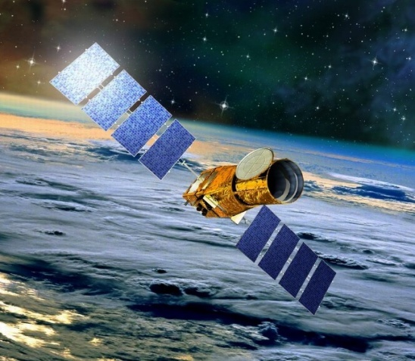
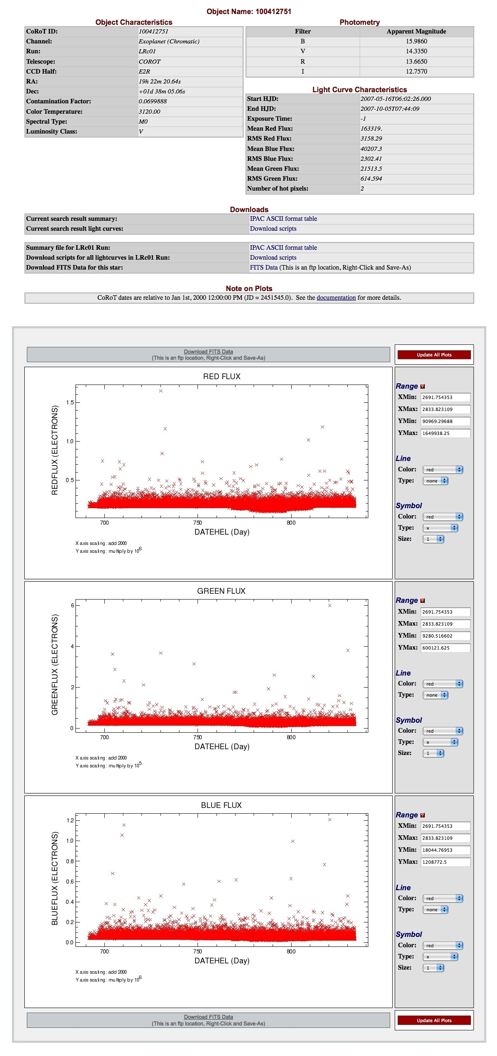
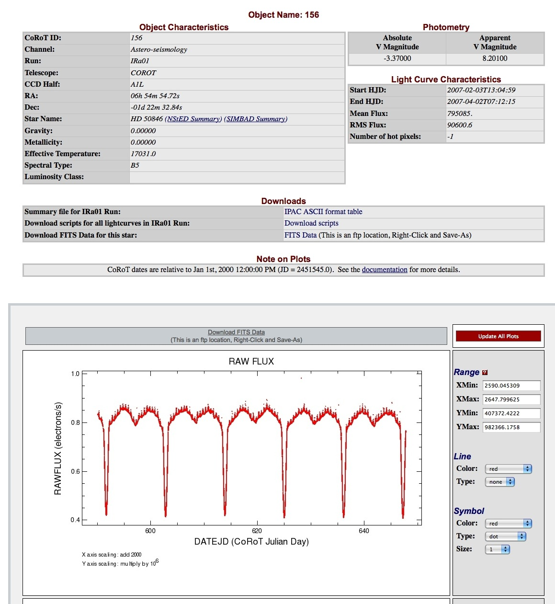
Partnership with CoRoT
NStED-CoRoT Collaboration
NStED is the U.S. portal to CoRoT mission data
CoRoT: COnvection, ROtation & planetary Transits
NStED hosts CoRoT mission and ground-based data
NStED and CoRoT collaborating to build light curve characterization and manipulation VO-compatible tools
NStED-CoRoT interface public deployment: 21 April 2009
Two public CoRoT runs
20,000 light curves with 10,000 – 300,000 epochs
NStED being adapted to support Kepler science analysis during mission operations

Slide 9
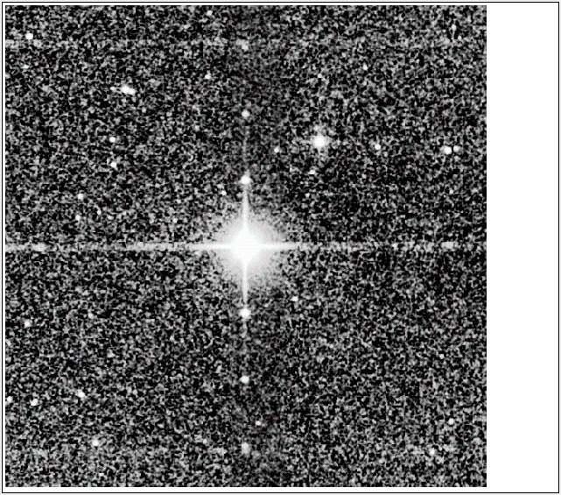
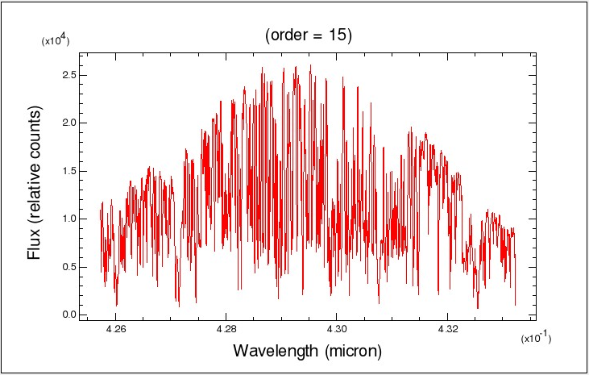
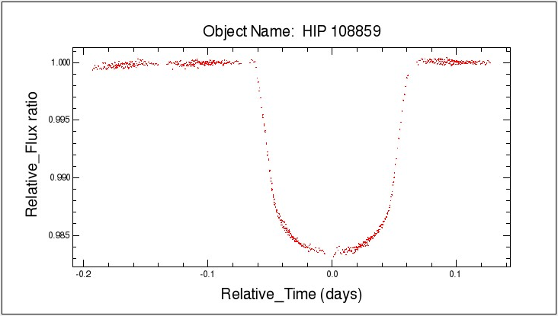
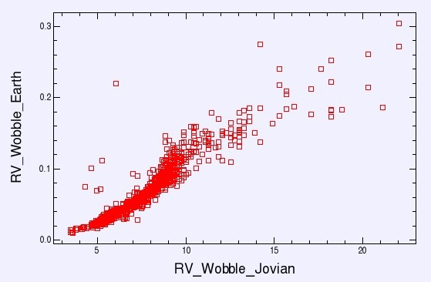
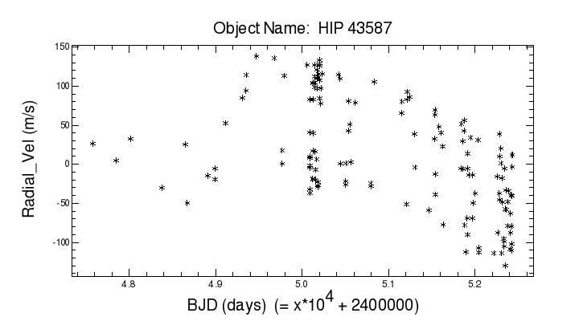
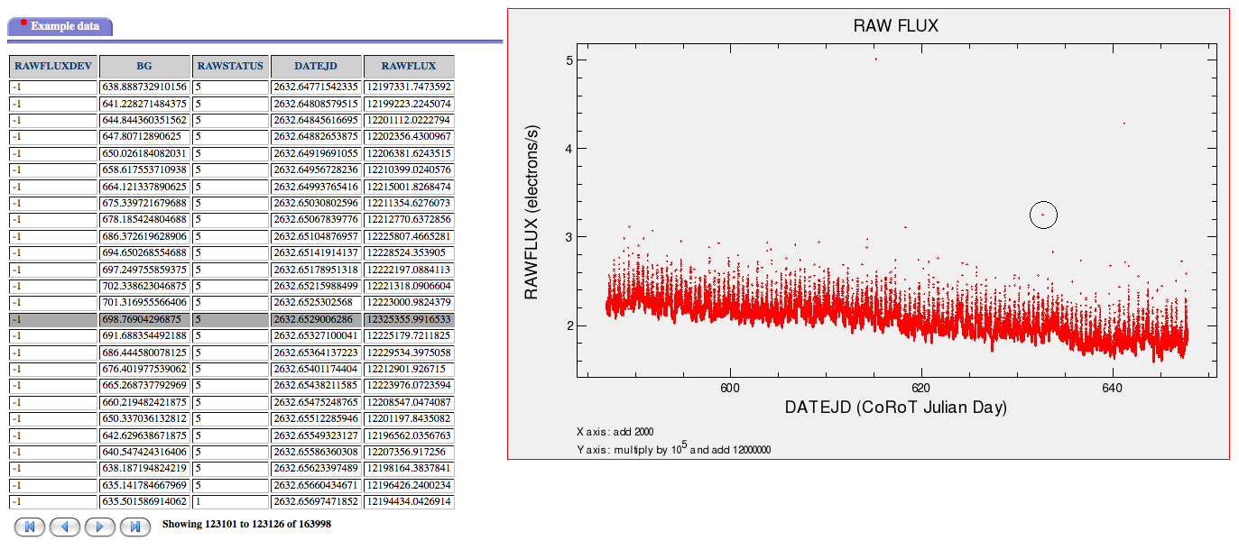
Visualization and Tools
Visualization of data all based on core IRSA code
Data Parameters
Images
Spectra
Photometric Light Curves
Radial Velocity Curves
Developing a more interactive toolkit
Interact with the data from the browser
“Plug-in” tools to manipulate and analyze data
Statistics
Periodiograms
Applying results of tools
See Peter Plavchan’s talk

Slide 10
Final Comments
NStED is a huge undertaking
Highly person intensive to ensure the data quality and content
Started as a proposal in 2004 and went into fully operations in 2007
Successfully went through the NASA Senior Review in 2008 along with IRSA and NED – NStED is now recognized as one of NASA’s funded archives
There is no way that could have happened if we had not built upon the IRSA and NED infrastructure already in place
A very big thank you to the entire NStED team – for without them, NStED would not exist!

