Slide 1
Detecting Transiting Planets
Systematic Sources of Error in Time-Series Data* and Period-Finding Algorithms
* Thanks to 2007 MSC Summer Workshop on Planetary Transits for hosting talk pdfs online.

Slide 2
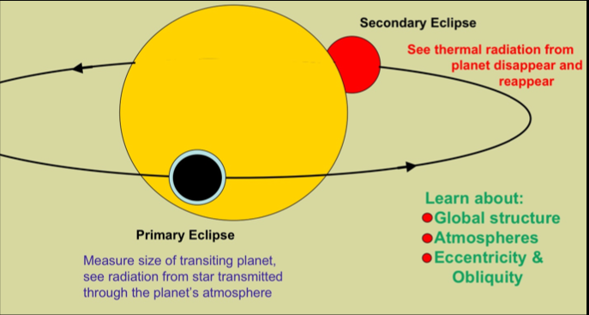
Transit Basics

Slide 3
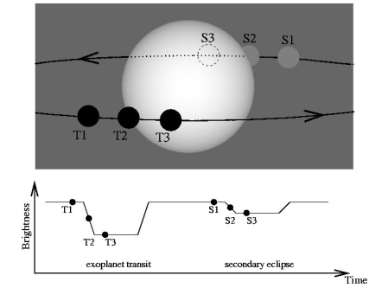
Transit Basics

Slide 4
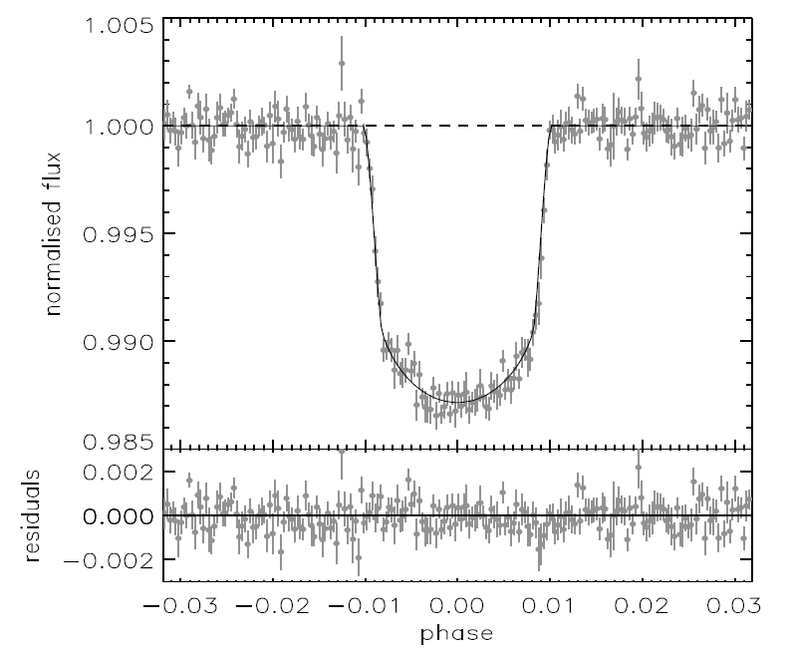
Real Data – CoRoT 4

Slide 5
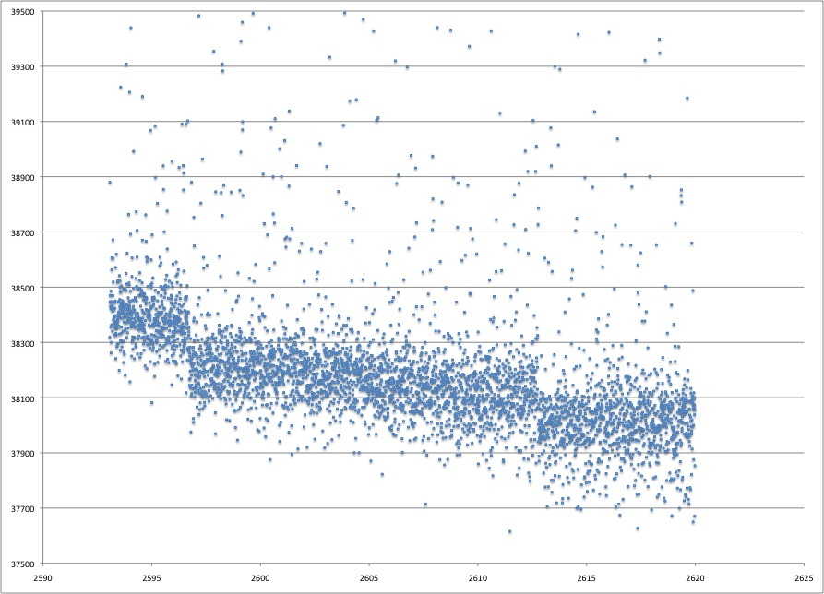
CoRoT “raw” data
Notes:
Three steps:
Relative Photometry
Detrending
Period finding

Slide 6
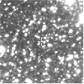
Photometry

Slide 7
Photometry

Slide 8
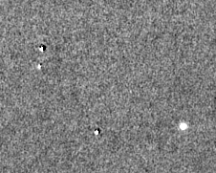
Difference Imaging Analysis

Slide 9
Difference Imaging Analysis

Slide 10
Photometry ➔ Light curve
Flux ratio (or magnitude difference) of science target(s) to non-variable reference star(s) yields “relative photometry” from which light curves are constructed, frame by frame.
Is that all we need to do to start looking for transiting planets? No, because of systematic sources of noise

Slide 11
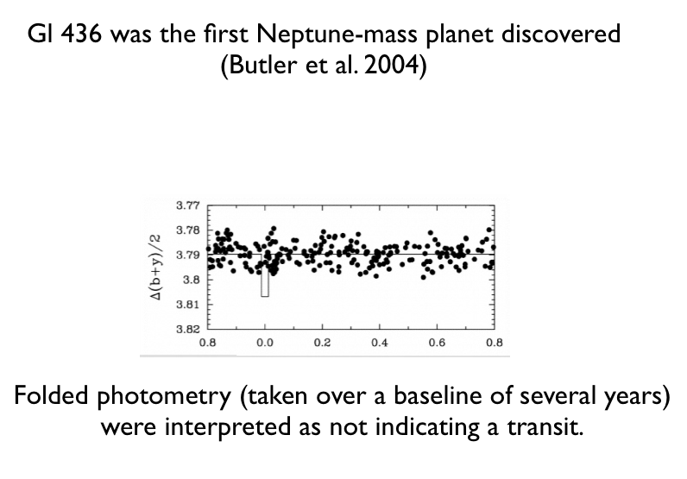

Slide 12
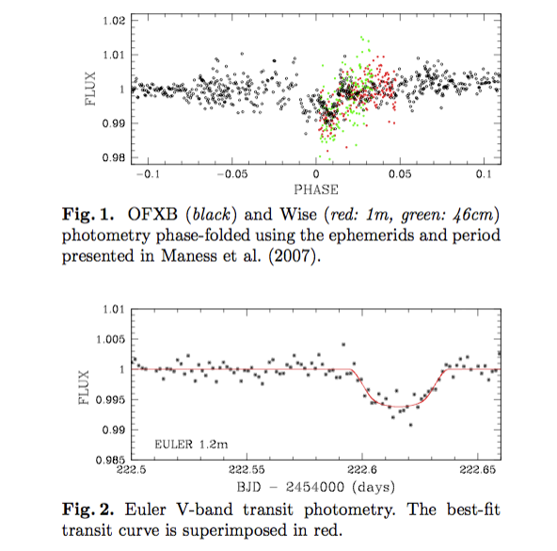

Slide 13
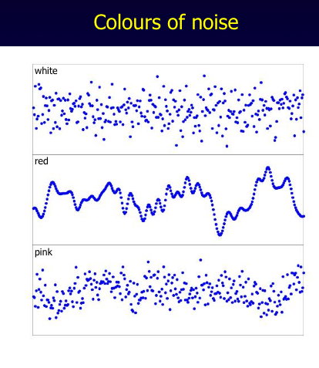

Slide 15
Sources of Systematic Noise
Airmass
Seeing
Crowding
Intra-pixel effects
Hot Pixels
Other Detector Effects
Astrophysical False Positives
➔ Ground based vs. space based and desired precision affect relevant importance of these noise sources

Slide 16
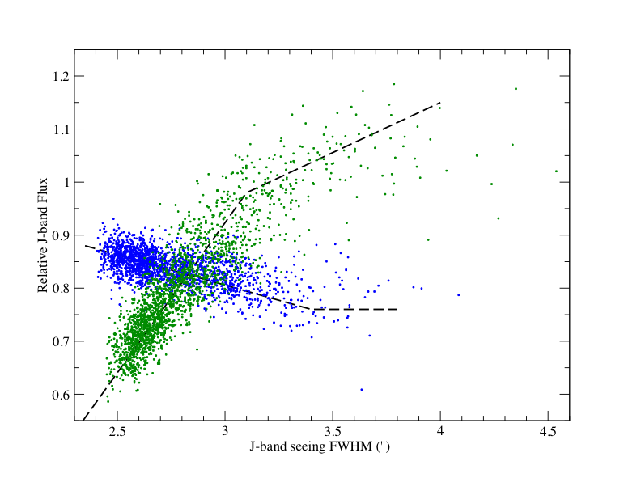
Seeing & Crowding

Slide 17
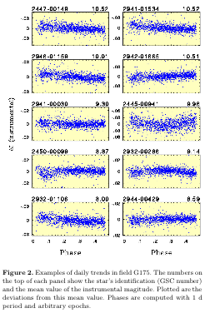
Airmass

Slide 18
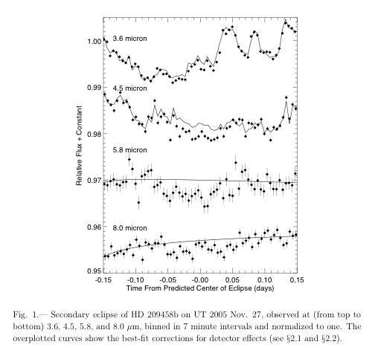
Intra-pixel Effects

Slide 19
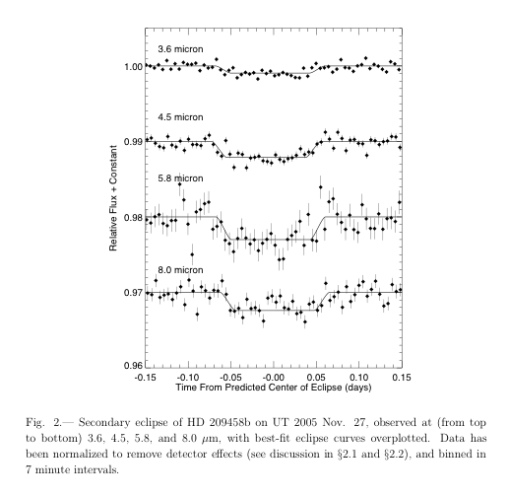
Intra-pixel Effects

Slide 20
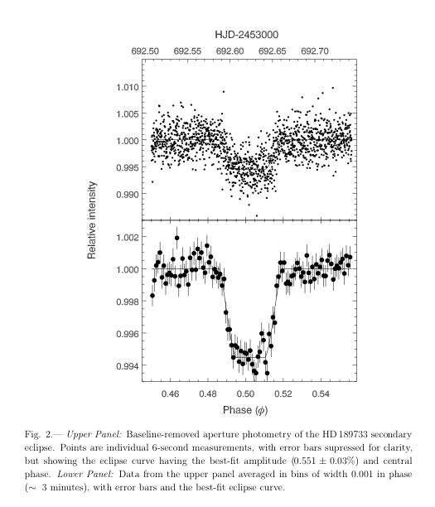

Slide 21
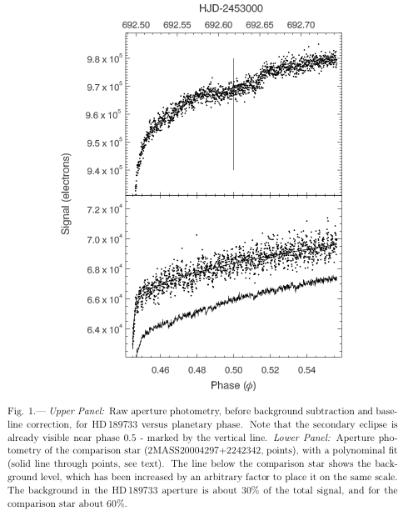

Slide 22
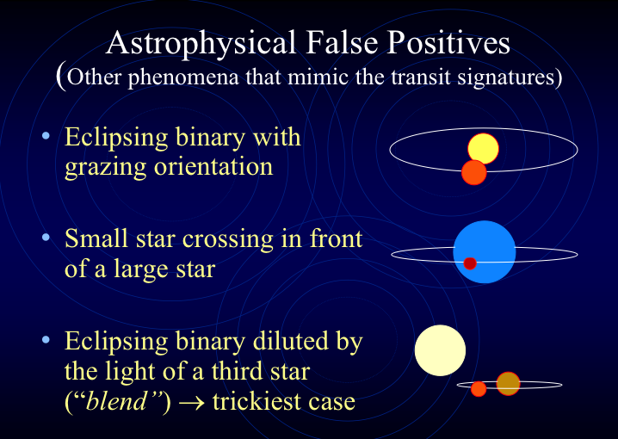

Slide 23
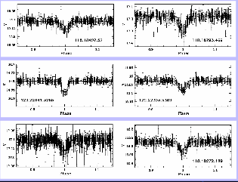
MACHO false positives

Slide 24
How to “De-trend” Light Curves
SYS-REM
  SYStematic REMoval
  “Correcting systematic effects in a large set of photometric light curves” Tamuz, O.; Mazeh, T.; Zucker, S., 2005, MNRAS, 356, 1466
  “The Sys-Rem Detrending Algorithm: Implementation and Testing” Mazeh, T.; Tamuz, O.; Zucker, S., 2007, ASPC, 366, 119
  Reduces to “Principle Component Analysis” for identical photometric uncertainties
TFA
  Trend Filtering Algorithm
  “A trend filtering algorithm for wide-field variability surveys” Kovács, Géza; Bakos, Gáspár; Noyes, Robert W. , 2005, MNRAS, 356,557

Slide 25

SYS-REM: Minimize S²
i = star #
J = image # / date
c = color dependent “extinction” correction coefficient
a = “airmass”
r = magnitude or relative flux
Sigma = photometry uncertainty
➔ Iterative Linear trend fitting and removal

Slide 26
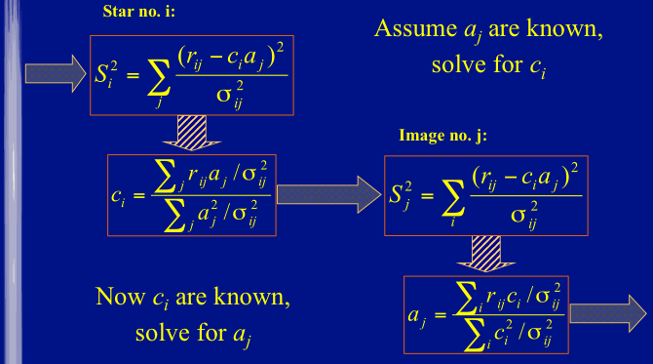

Slide 27

TFA

Slide 28


Slide 29
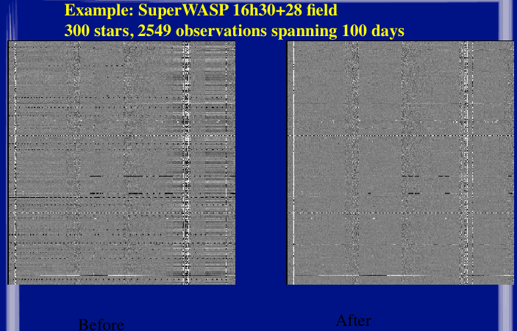

Slide 30
Detrending algorithms
TFA ➔ takes trends from linear combination of randomly selected sub-sample of light curves stars in field to serve as trend “templates”. Can benefit with the period of the science target variability is already known.
SYS-REM ➔ fits linear trends with no apriori knowledge of trends or periods.
Both algorithms are iterative.
Both algorithms require convergence criteria, or times to stop, and this is somewhat of an art form.
For SYS-REM, stopping criteria is determined by comparing the ratio of the global dispersion (standard deviation) of photometry before and after the detrending; with a limiting threshold.

Slide 31
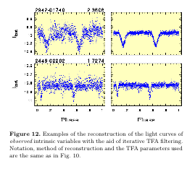
TFA improvements

Slide 32
Period Finding
Brute Force
  Search through 10,000’s periods
  For each period, “fold” the light curve to that period
    phase = (date modulo period) / period
  Calculate some quantity based upon a specific algorithm to evaluate the significance of the “test” period
  Generate a “periodogram”, and “peaks” in the periodogram may correspond to the correct period

Slide 33
Periodogram Algorithms
Lomb-Scargle
  Scargle, 1982, ApJ, 263, 835
Box Least Squares
  Kovacs et al., 2002, A&A, 391, 369
Strlen
  Min( Σm_{i+1} – m_{i} ) , m_{i} are ordered by phase after folding
Analysis of Variance
Phase Dispersion Minimization
Plavchan
  Plavchan et al. , 2008, ApJS, 175, 191

Slide 34
Why not generate FFT?
Fast Fourier Trransform assumes the observations are evenly spaced in time, with no gaps.
  Real time series observations rarely meet this criteria
  Daylight gets in the way of ground-based efforts
Lomb-Scargle is effectively a FFT for unevenly sampled data
  For a trial period, fit data to sine wave. Amplitude of sine wave yields significance of the trial period.

Slide 35
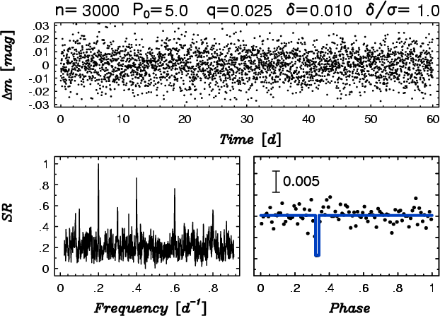
Box Least Squares
Instead of sinusoids, take data folded to trial period and fit to “box-like” transit curve.

Slide 36
Plavchan Periodogram
Maximize:

Slide 37
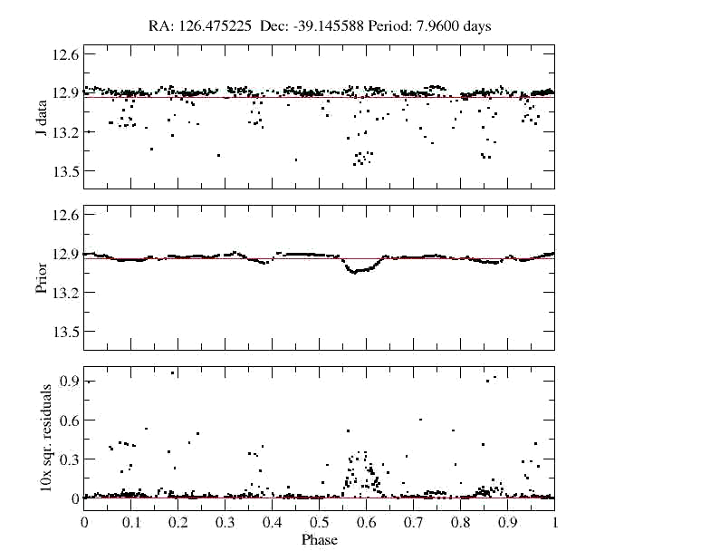

Slide 38
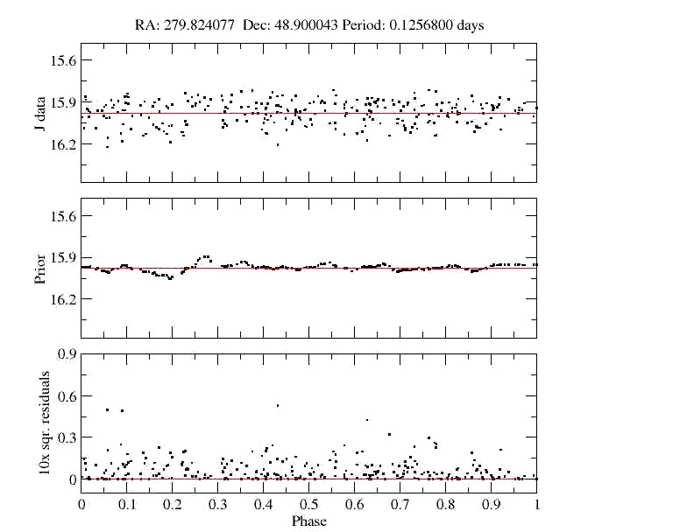

Slide 39
Plavchan Peridogram

Slide 40
N-D Plavchan Periodogram
The numerator and denominator are 1-D vector magnitudes

Slide 41
Conclusions
Published light curves of transiting planets hide the massaging and removal of systematic sources of noise, but fortunately these tools exist.
Finding a transit signal in a light curve is a brute force extension of a Fourier Transform, with a careful choice/substitution of “basis functions”

