Slide 1
Virtualization in the Data Center
Virtual Servers
  How it works
  Pros
  Cons
IPAC’s implementation
  Hardware resource usage and trends
  Virtualization examples

Slide 2
How Virtualization Works
Hardware
Hardware
Virtualization Software
Virtualization Software
OS

Slide 3
Smaller foot print in the DC
400 Watts
400 Watts
400 Watts
400 Watts
400 Watts

Slide 4
More efficient use of hardware
10%
20%
80%
25%
25%

Slide 5
Preserve legacy applications
Hardware
Virtualization Software
Redhat 8

Slide 6
Develop, Test, and Deploy
Development
Testing
Production

Slide 7
Cons
Too many virtual servers can crash the physical server
Shared I/O may lead to bottlenecks

Slide 8
IPAC OS Demography
* servers only

Slide 9
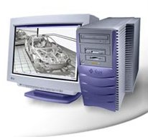
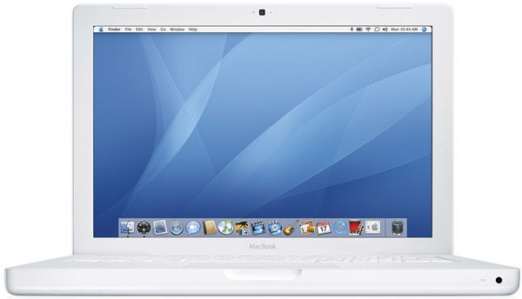
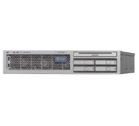
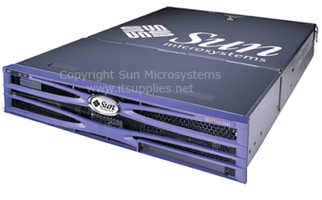

IPAC OS Trends
Desktop
Sun to Mac
File Server
Solaris Sparc to Solaris x86
Common Services (Web)
Solaris to Linux

Slide 10
Old Purchasing Model
Buy hardware to fit the Operating System
Must choose OS at purchase time
Changing software may require new purchase
Upgrade
Sparc
Solaris
New Purchase
x86
Linux
Upgrade

Slide 11
New x86 Purchasing Model
Buy hardware to fit the computing requirements
Choose software later
Repurpose HW if desired
Upgrade
Repurpose
Solaris
New Purchase
OS Type
x86
LInux

Slide 12
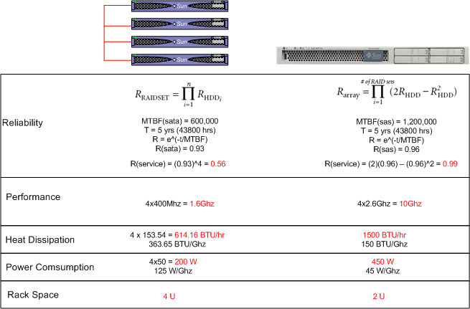
Consolidation with Virtualization
*straw man comparison

Slide 13
VM technologies at IPAC
Xen – Open Source, supported on Linux
Zones – Software Partition, on Solaris
Logical Domains – Hardware Partitioning, supported on Sparc servers
VMWare – Multi-OS capable, common on desktops, experimental on servers
Parallels – being phased out for VMWare

Slide 14
Oracle Server Build
OS Install (4)
Oracle Install (x)
Hardware Org (4)
Production
(x+80) hrs
Real Example: Project X wanted a test Oracle server deployed same-day
Challenge: No hardware , little time
Tradition
OS Custom (1)
Oracle Install (x)
Clone VM (1)
Production
(x+2) hrs
The VM way
Outcome: Server functional in 8 hrs

Slide 15
Java App Server Dev to Ops
OS Install (4)
Java Runtime (x)
Hardware Setup (4)
Production
(x+8) hrs
Real Example: Project Y wanted to move the Java App from a Dev environment Ops
Challenge: Minimize work for Project Y and ISG
Traditional
OS Custom (1)
Java Runtime (x)
Copy Dev to Ops VM (1)
Production
(2) hrs
Hardware Setup
The VM way
Outcome: Delivered 2 Ops replicas of Dev server same day

Slide 16
How to Manage VMs
xen1
CPU (4)
xen2
CPU (8)
xen3
CPU (16)
MEM (8G)
Disks (50G)
MEM (16G)
Disk (1T)
MEM (32G)
Disk (2T)
Abstraction with Bit-Buckets: Each server is a bucket of resources CPU, Memory, Disk
Eliminate cutesy names and dedicated roles for the hardware
010110
My App Needs
CPU 8
MEM 8G
Disk 50G

Slide 17
VM Resource Math
Filling the Bit Bucket
Adding My App to a VM server reduces the VM resource and increases utilization
xen3
CPU (16) 100%
My App
CPU (8)
xen3
CPU (8) 50%
MEM (32G) 100%
Disks (2T) 100%
MEM (8G)
Disk (50G)
MEM (24G) 50%
Disk (1.9T) 99%

Slide 18
Virtualization In Use
Linux 8 core (8:1)
1 ISG Java
2 ISG Test
Solaris 2 core (3:1)
Web (ipac)
Curator (staff)
1 Project Oracle
1 ISG Web
1 Project Tomcat
Ftp (anon-ftp)
IPAC-wide: 32 servers supporting 60 VMs
Virtualization ratio 2:1 – 2 OS running on each CPU core

Slide 19
Summary
Virtualization is efficient and cost-effective
I/O performance is a challenge
Consider going virtual when buying HW/building servers
Benefits usually outweighs the costs

